Slide 1
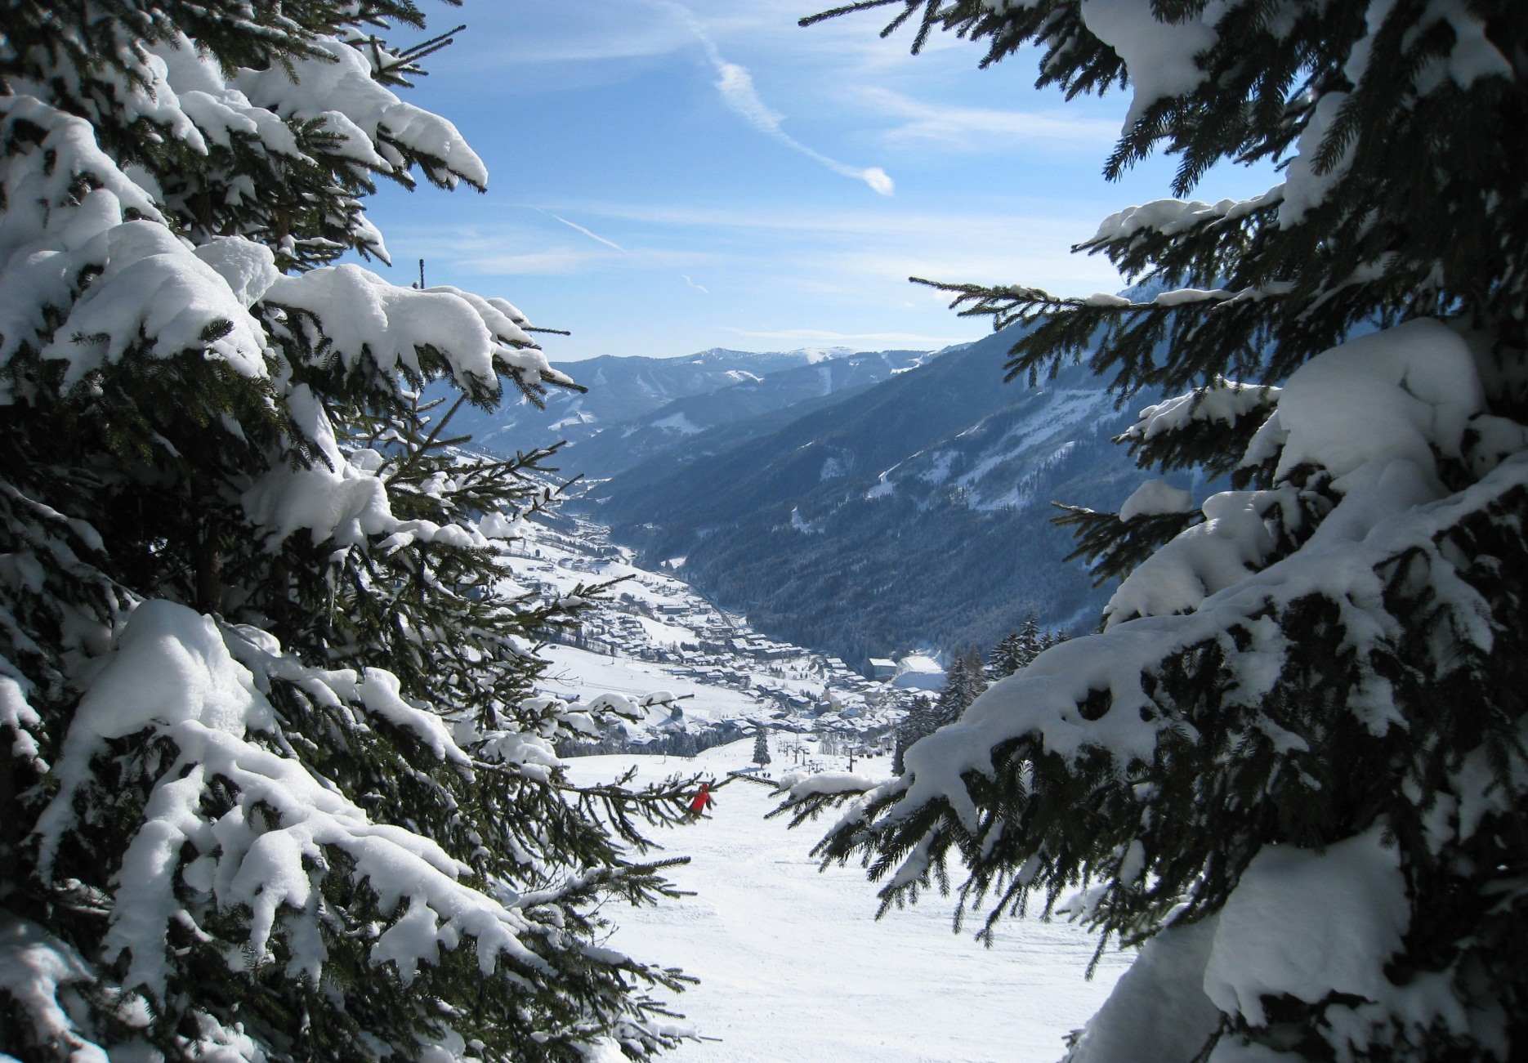
King James’s School SKI TRIP 2023 Bad Gastein Austria

Slide 2
BAD GASTEIN AUSTRIA

Slide 3
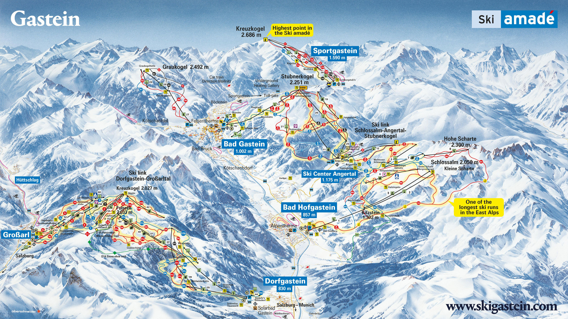

Slide 4
Gastein valley encompasses four different mountains and their related ski resorts of Gastein, Dorfgastein, Bad Hofgastein and Sport Gastein.
Over 175 km of skiing
Runs of heights of over 2,500 metres, thus ensuring great conditions until well after the British Easter holidays.
Full range of slopes regarding difficulty
Other activities include a fun slope, a giant slalom course with a Skimovie feature and a snowpark.
From the Stubnerkogel, take in the spectacular views of one of the longest suspension bridges in Europe at 2,300 metres

Slide 5
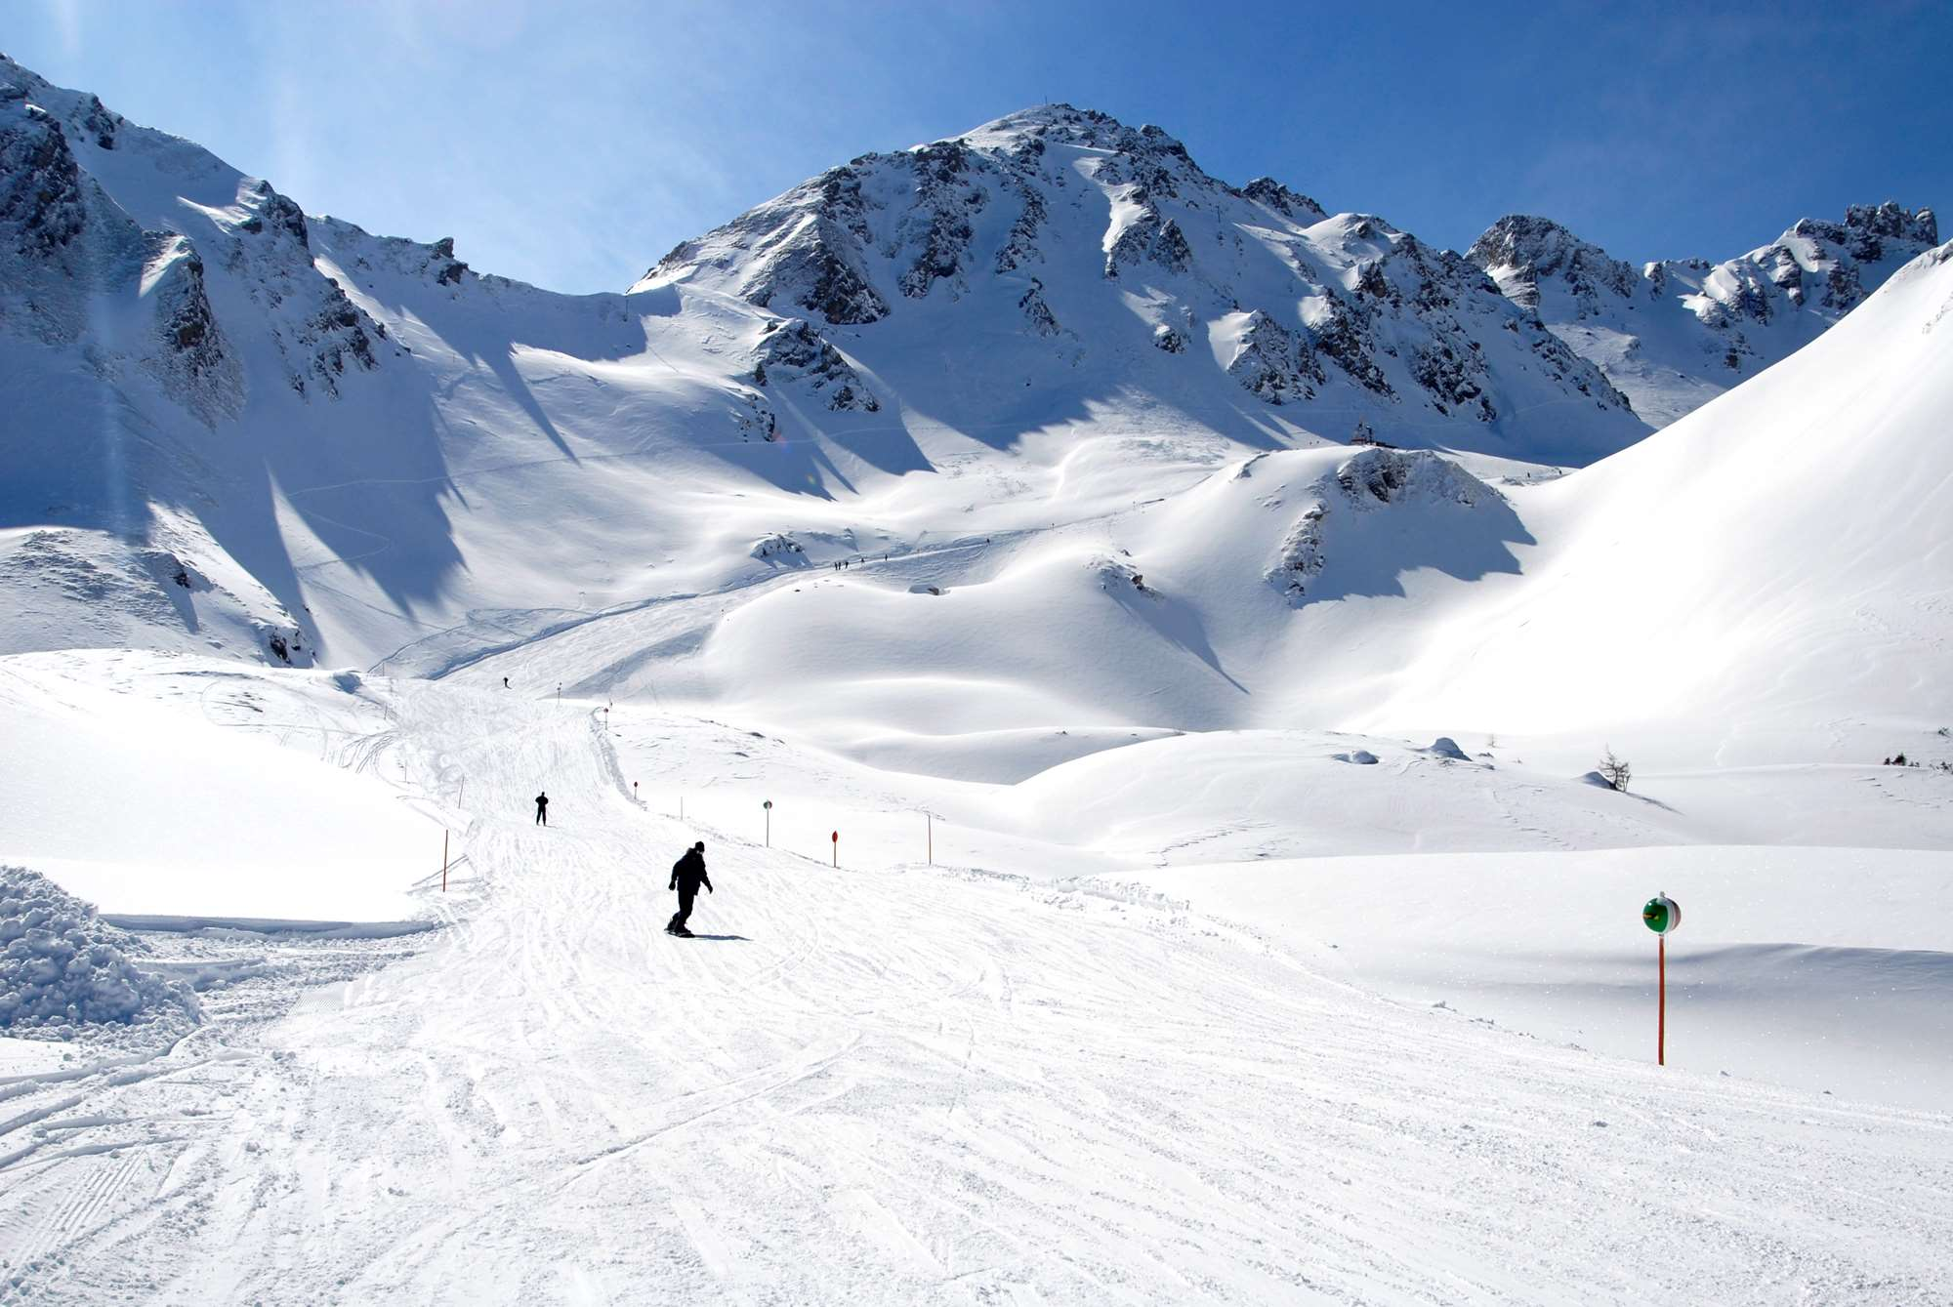

Slide 6
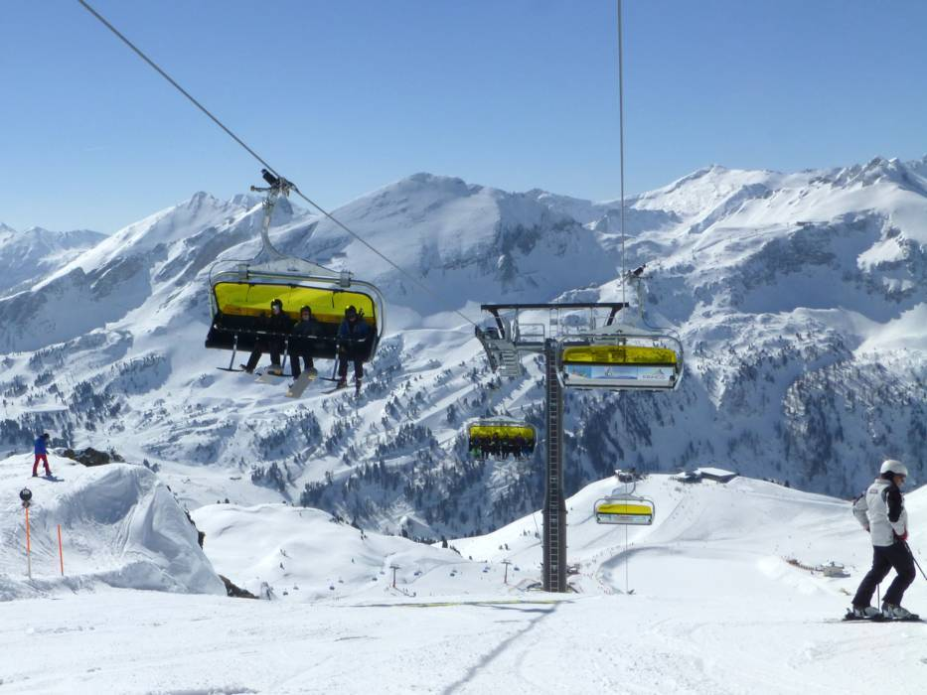

Slide 7
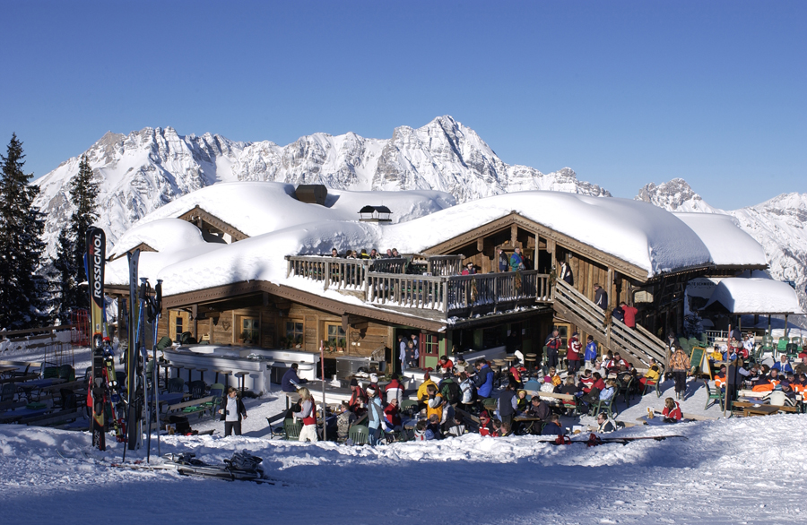

Slide 8
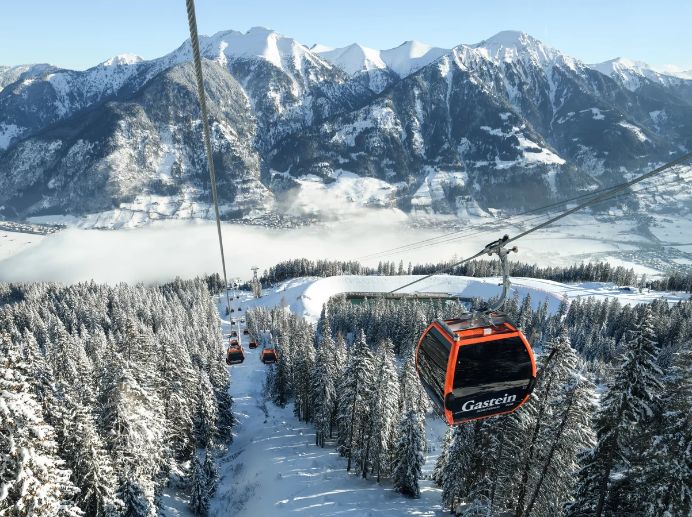

Slide 9
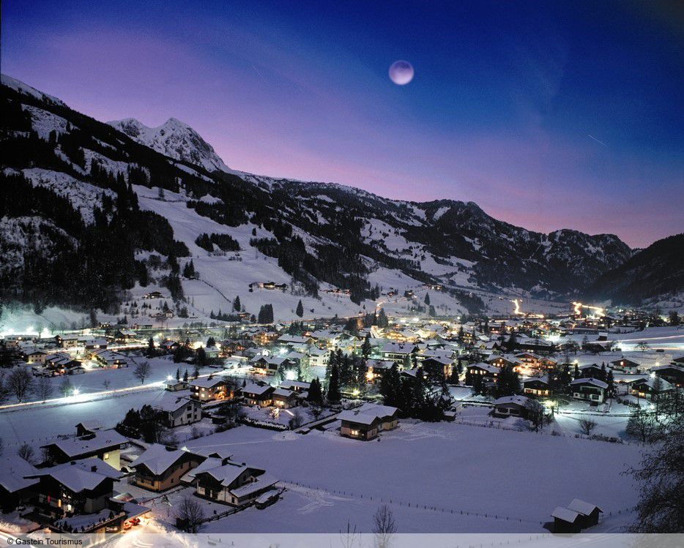

Slide 10
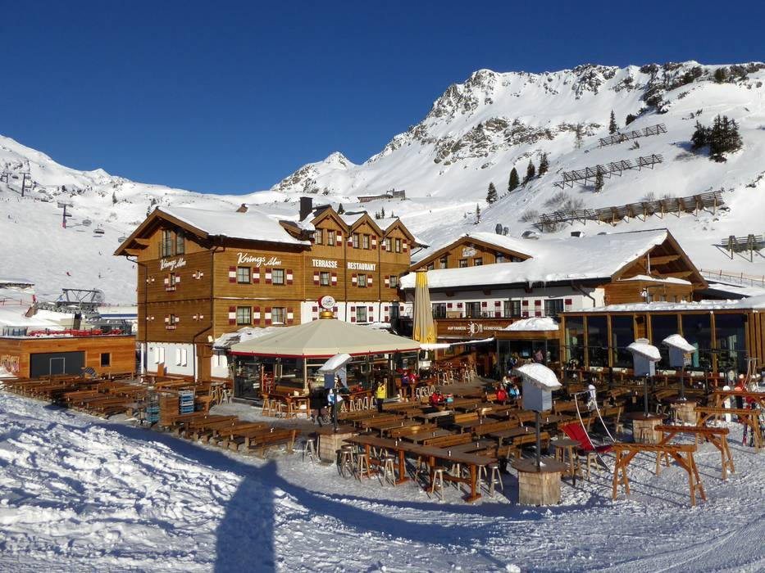

Slide 11
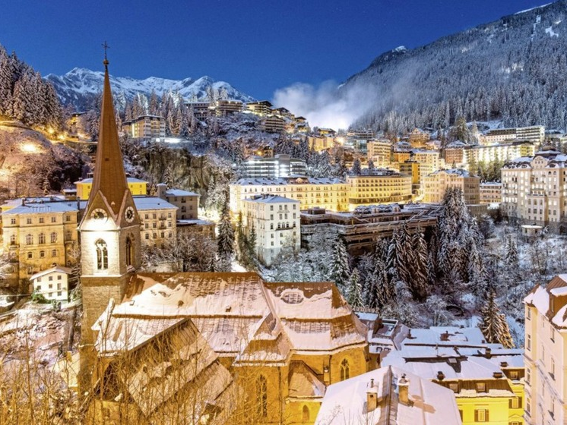

Slide 12
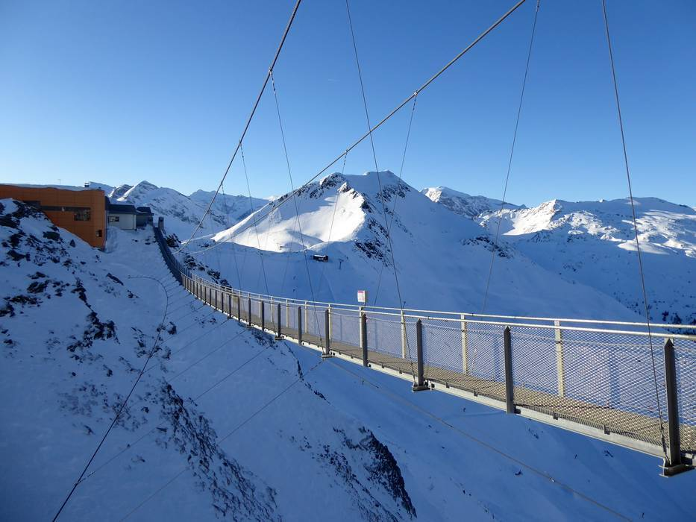

Slide 13
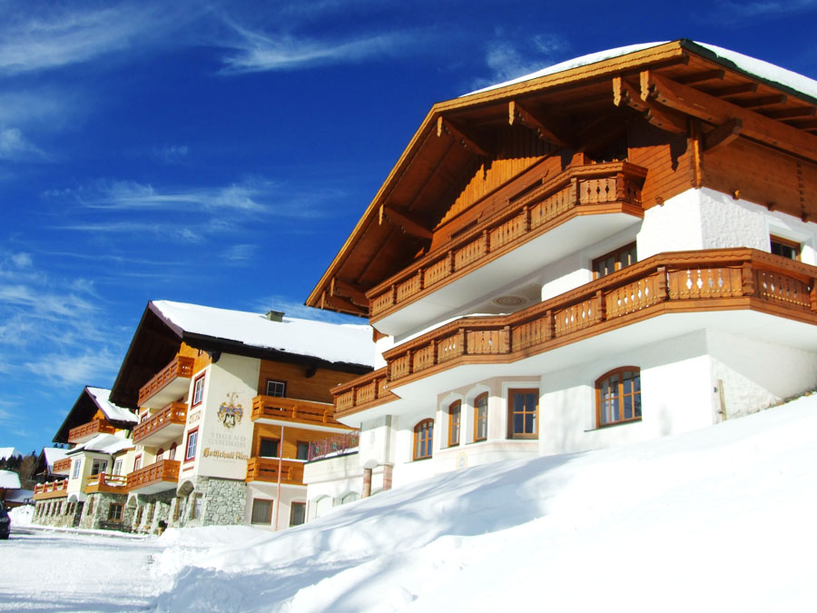
Jugendgastehaus Gottshallalm

Slide 14
Saturday 1st April
to
Friday 7th April 2023 (Easter break).

Slide 15
Staff
Mr Bolger (Trip Leader)
Mrs Rees
Mr Keeble
Ms Watson
Mrs Cooper

Slide 16
In loco parentis

Slide 17
Saturday 1st April: Day of Departure
Meet at school at 2.15am – load bags onto coach
Travelling Money – Sterling, Euros, (including 50cent coins)
Hand Luggage – Food (no nuts), snacks/ water for the journey (no fizzy or energy drinks allowed at any time during the trip). Wash bag, wet wipes/ tissues, ski-socks
Loose, comfortable clothing - including a Pillow/ neck-rest and small blanket (optional)
Entertainment for the journey - music; magazines; books; games etc.
Mobile Phones – Don’t bring them ☺☺☺
Coach departure time 3am

Slide 18
Travelling
Travel sickness pills – your responsibility
Prescription medication – hand to me on the day
Seat belts – 200 Euro fine
Staff seated near all exits – that means the front and rear/ side of the coach
Aerosols – not to be used on the coach
Banking/ muster groups
Airport and service stations - muster groups and meeting points

Slide 19
Arrival
Depart Manchester Airport at 06.55am FLIGHT LH2505
Arrive Munich at 09.50am
Coach transfer to resort approximately 3 hours
Rooming allocated – 4-6 students per room - you will be sharing with at least one of your friends (probably all of them)
Ski fitting – Skis, helmet and boots will be allocated upon arrival
Dinner – an evening meal, messages and then time to unpack and acclimatise before settling down for bed
Staff duty rota – Students informed of named duty staff and where their rooms are situated
7 Apr 2023 2200 MUNICH - TERMINAL 2 MANCHESTER TERMINAL 1 2300 LH2504

Slide 20
A Typical day
7.15am – wake-up call
7.45am – Breakfast
8.30am – ready for the slopes in full ski-wear
9am – meet instructors on the slopes and begin three hours of ski lessons
12pm – Lunch
1pm – Two more hours of ski lessons
3pm – All groups meet up and then make their way back to the hotel
3.30pm – Place boots and skis in bootroom

Slide 21
Après ski
4-6pm – Showers and chill out time
6-7pm – Dinner, messages and banking
7pm – Evening entertainments/ chill out
9.30pm – Back at the guesthouse for daily awards and messages
10pm – Everyone back in their own rooms and ready for bed
10.30pm – Lights out and…sleep.

Slide 22
Return
Friday 7th April – Full day of skiing as per usual
3pm – Return all ski equipment
4pm – Meal followed by presentation of slalom ski awards/ medals and gifts for instructors
5.30pm - Coach departs resort
10pm FLY FROM MUNICH - TERMINAL 2 LH2504
Arrive MANCHESTER TERMINAL 1 at 11pm
Board coach at 11.45pm
Arrive back at school on Saturday 8th at approximately 2am

Slide 23
Final Preparations
Consent form
Passport
GHIC - www.eu-healthcard.com
Insurance – Fully comprehensive winter sports cover
Medication
Medical/ accidents
Ski Fit – start now
Payment of final balance – Friday 13th January

Slide 24
Hoodies

Slide 25
What To Pack
Casual clothes for evenings – jeans, joggers, T-shirts
Jumper/ Hoody
Outdoor shoes/ trainers
A bag/small rucksack (useful but not essential)
Nightwear
Towel
Wash kit

Slide 26
Essential Skiwear Items
Ski jacket
Salopettes
Ski gloves
Ski socks
Goggles and sunglasses (goggles are the priority)
Underclothes for skiing – a thin layering system is better than one thick layer.
Sun cream and lipsalve

