Slide 1
Year 12&13 Parent Revision Evening Monday 26th February 2024

Slide 2
Aims of the session
How does memory work?
What are the best ways to revise?
What revision support is available?
How can you support from home?
What are the exam rules and regulations
What to expect during the exam period?

Slide 3
Cognitive Science How does memory work?

Slide 4
How will I remember everything?

Slide 5
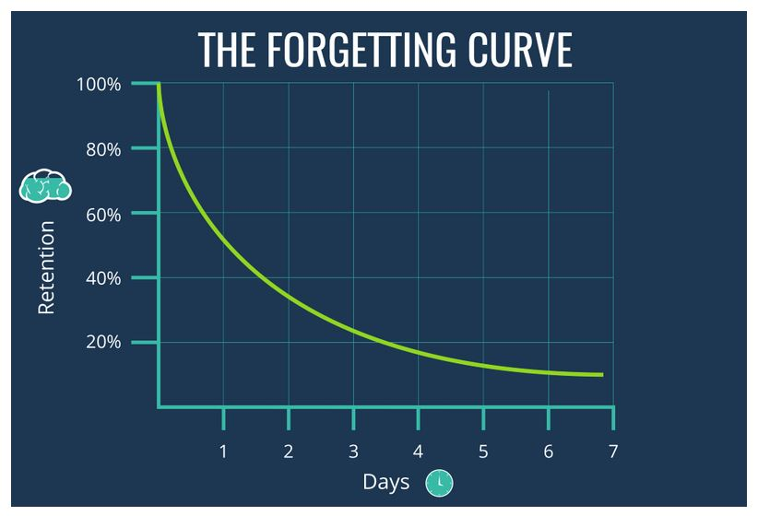
Why do we forget things?

Slide 6
“Learning involves a lasting change in pupils’ capabilities or understanding.” (Department for Education, 2020)

Slide 7
W T O H G H A C T D T G O I P O C A

Slide 8
C O W P I G T O P H A T D O G C A T

Slide 9
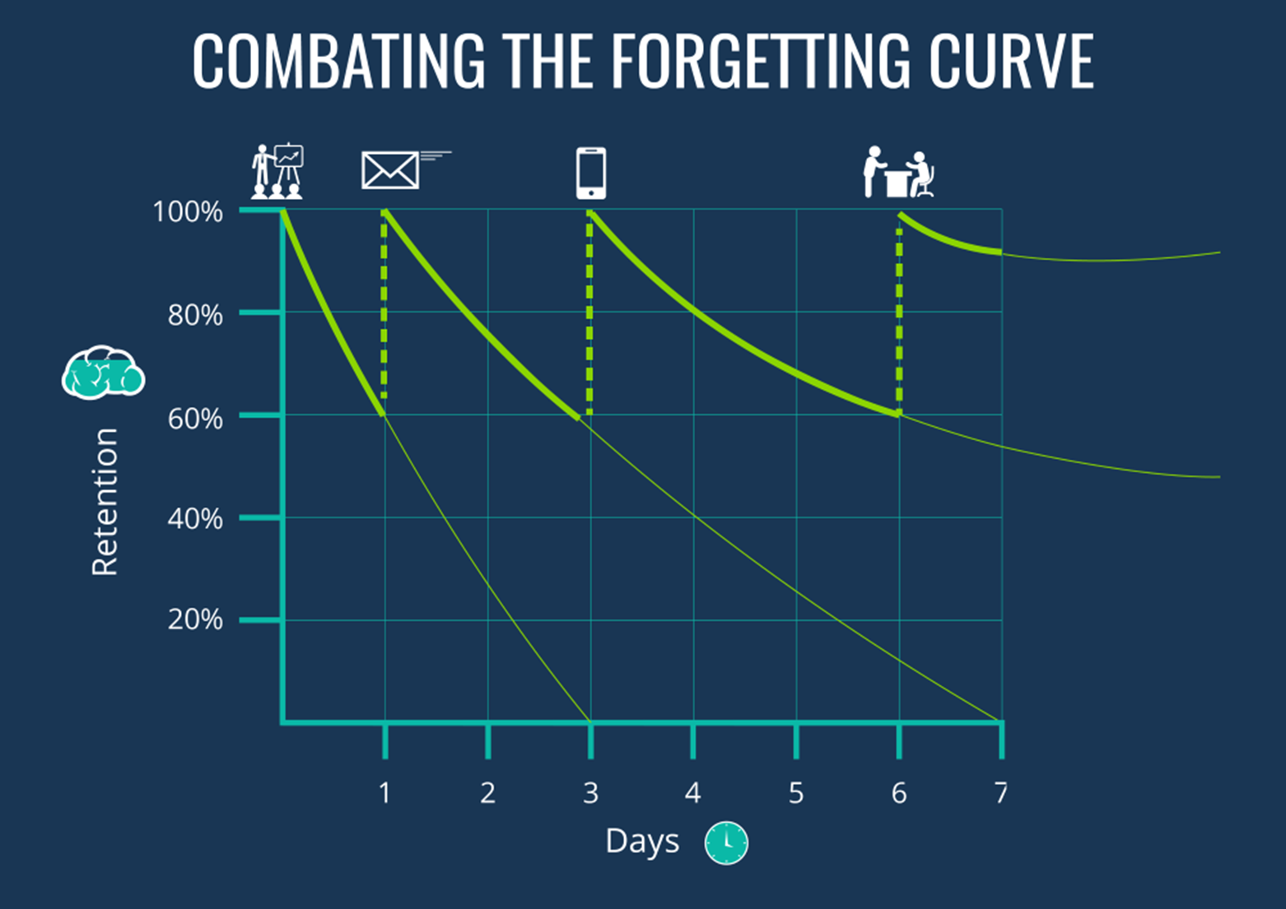

Slide 10
What are the best ways to revise?

Slide 11
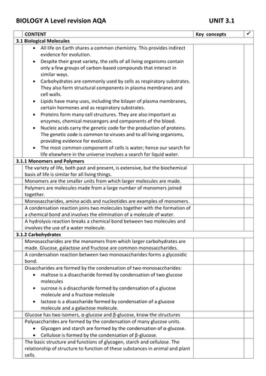
HAVE YOU GOT A FULL SET OF NOTES?

Slide 15
The chunking technique
Break down information into manageable chunks
Identify similarities or patterns
Organise the information
Group into manageable units
Use headings, titles, bullet points

Slide 19
Flash cards need to become your new best friend when it comes to revision!
The main purpose of flash cards should be self-testing to strengthen information in long term memory and provide instant feedback to identify gaps in your knowledge.
They are one of the most effective revision strategies when used correctly!
Create flash cards with the question on one side and the answer on the other and test yourself/ask someone at home to help you.
Flash cards DO NOT need to be flashy/pretty – simple is best.

Slide 23
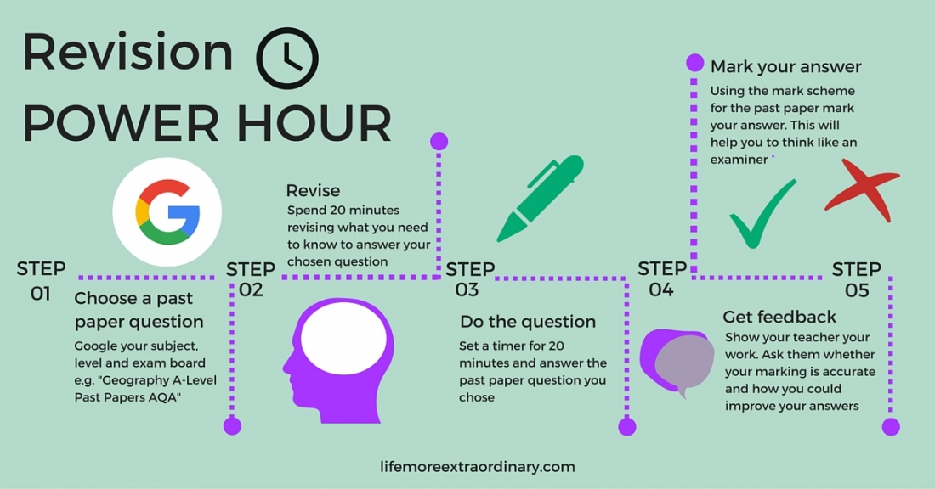

Slide 24
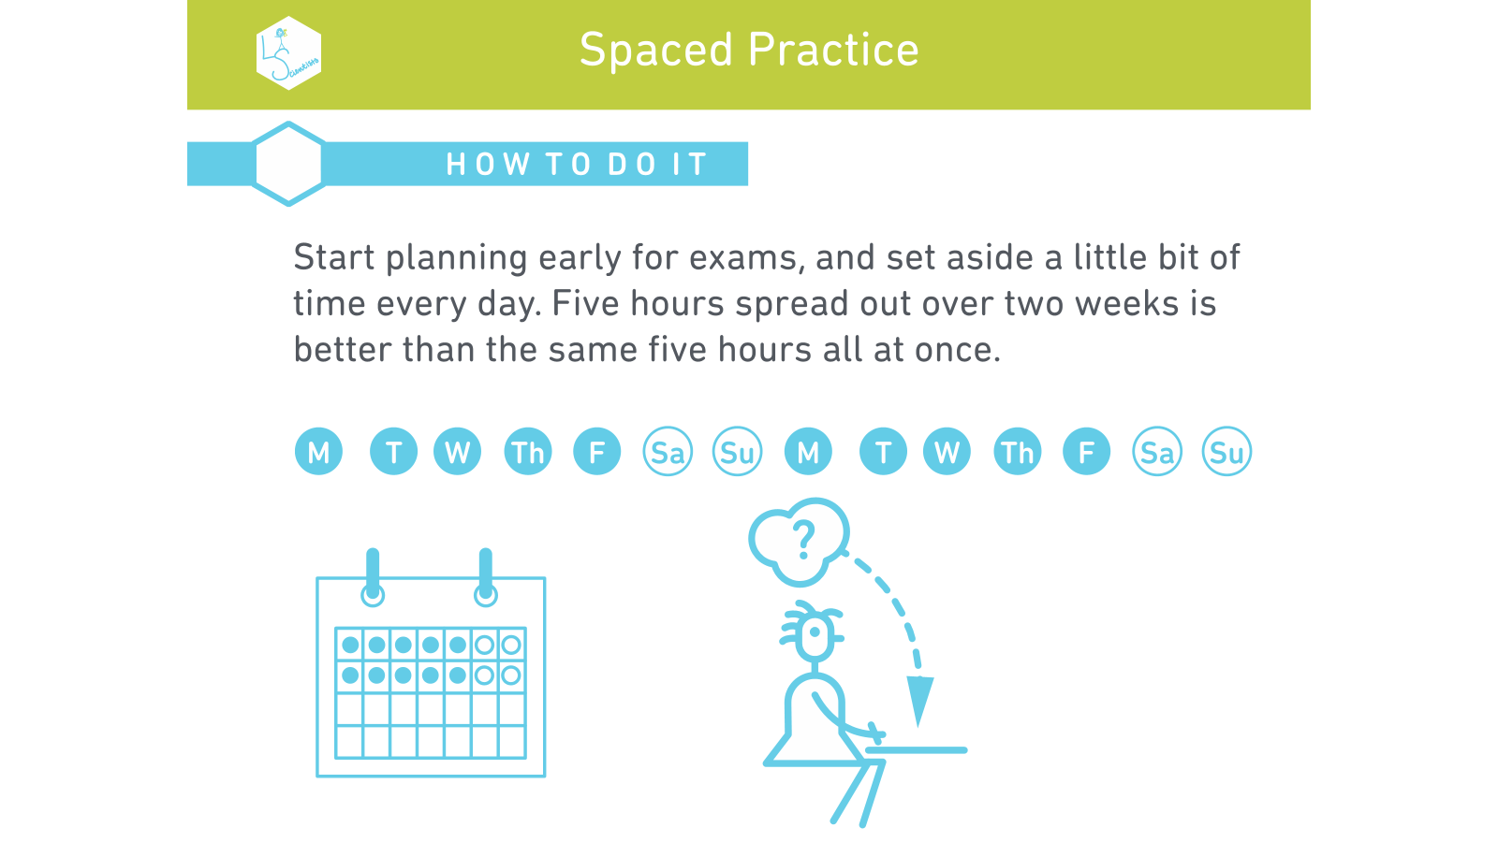

Slide 26
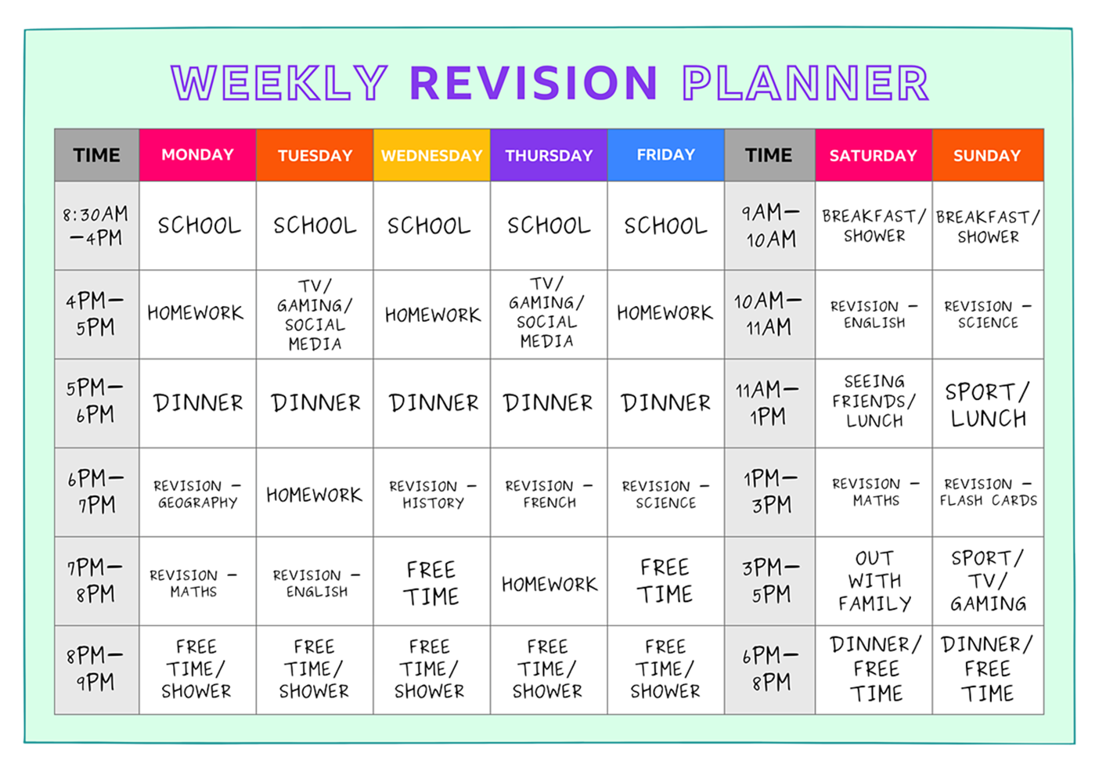

Slide 28
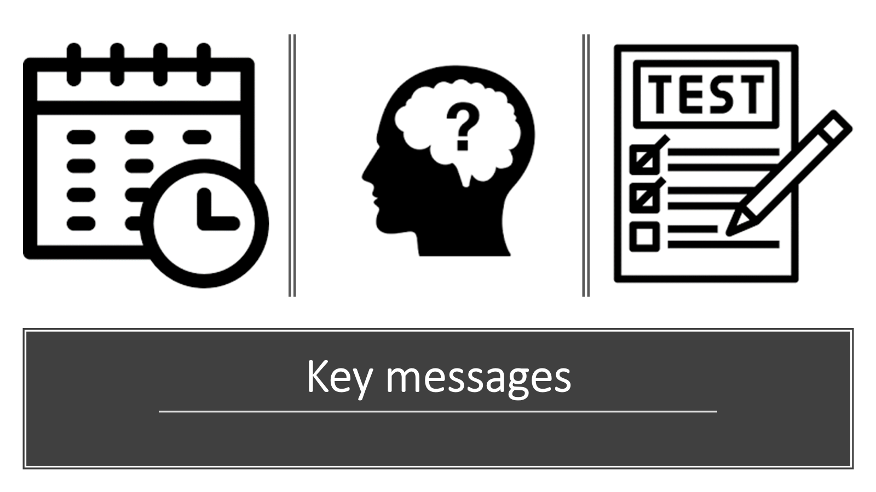

Slide 29
What revision support is available?

Slide 30
King James’s school website

Slide 31
How can you support from home?

Slide 33
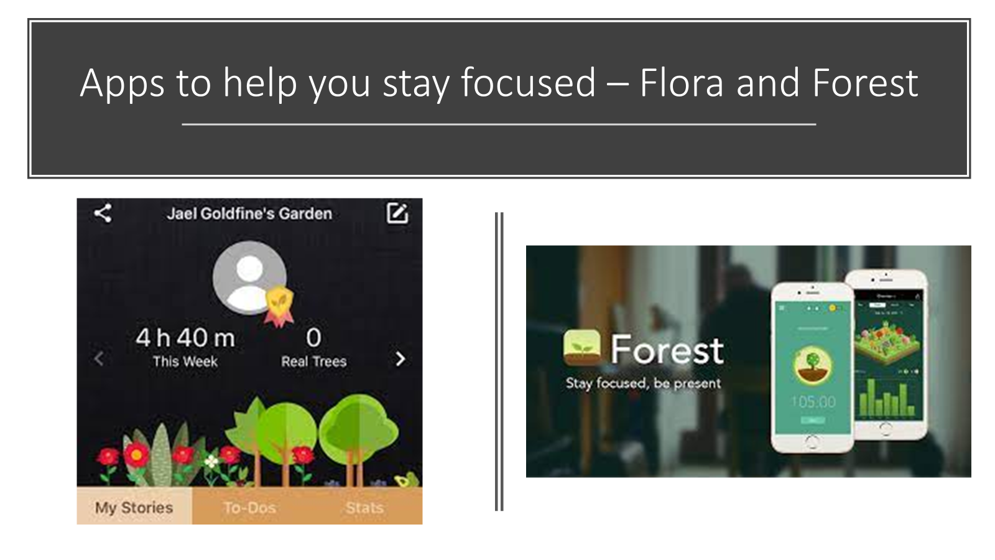

Slide 35
BBC Bitesize – Exam stress ‘How can parents help?’

Slide 36
What are the exam rules and regulations?

Slide 37
JCQ and Examination Boards
The conduct of examinations is completely governed by JCQ on behalf of the exam boards.
Once the students begin their assessments, they will have to follow JCQ rules and school must enforce them.
If either students or the school fail to follow the rules it is called “malpractice”. This can lead to disqualification.
Exam board rules of conduct are strict. Ignorance is not an excuse. We practise them in Mocks ready for the real thing.
The codes of conduct are designed to be fair, but are consistently applied.

Slide 38
Non-examination Assessments
This may be coursework, portfolio work or practicals.
Each assessment will have a specific set of rules to follow e.g. word limit, time taken, sources that can be used.
Students must be careful regarding plagiarism and the use of A.I.
Any worked signed and submitted as their own, will be checked for non-attributed sources (e.g. cut and pasted from the internet) and “lacking student voice” (e.g. written by A.I. bot in a style not consistent with the student.)
Any work that fails these tests will be reported and likely to be disqualified.

Slide 39
Preparation and Conduct in Exams
Students are well prepared for the rules of the examination hall e.g. use of calculators, colour of ink, no smart tech etc. There will be a further assembly dedicated to this.
The invigilator team report all disturbances, even minor ones, to the examination office and exam board. This is particularly important when there are multiple examinations in one space.
If a student arrives late for any reason they will be seated and allowed the full time. The exam board will judge if any advantage has been gained.
Some examinations finish after normal school hours.
Illness or other unforeseen issue must be reported to school as soon as possible.

Slide 40
Examination Issues
If unforeseen issues affect a student, the school must be made aware as soon as possible. The Exam Office will liaise with the examination bodies. No direct contact with candidates will be accepted by the JCQ.
Please be aware that the examining bodies’ default position is not to interfere with any marks. Grading based on mitigating circumstances will be applied if the situation meets relevant criteria.
In very rare circumstances, the school will be required to provide additional examples of student assessed work.
Absences from examination are recorded as X and receive zero marks. The award of an overall grade with mitigating circumstances will be indicated on the results.

Slide 41
Post Exam Queries
The final grades are produced for the student by the examination board. We can only release grades to the student in person. If the student is unable to attend this must be organised in advance with a formal written request from the student.
If the student wishes to have their grades reviewed after results are published, there are a number of options which can be applied for via the examination office.
These requests must come through school and the priority service chosen if University entrance depends on it. Please note, the institution must also be contacted. Places are not guaranteed to be held.
We endeavour to support as much as possible, but there limits to the capacity and authority we have post-results.

Slide 42
What to expect during the exam period?

Slide 43
The Examination Period
Year 13 Students remain on roll at school until 30th June 2024
Expectations of students during exam season:
The expectations of Year 13 students during the exam season will be:
100% attendance until week ending 9th May 3.15pm.
Full uniform when in school at all times, including exams.
Excellent behaviour and engagement.
Students have read and adhere to the exam rules and regulations.
Bring the correct equipment for each exam.
For the period from 13th May onwards, teaching staff will be in their timetabled lessons until the examinations for that subject are over. Given the variety of combinations of subjects across our students, staff will tend to liaise with them directly regarding specific revision during this period. The students will be free to attend their scheduled lesson times and use the Sixth Form study facilities, where available.

