Slide 1

Year 10 books to choose from

Slide 2
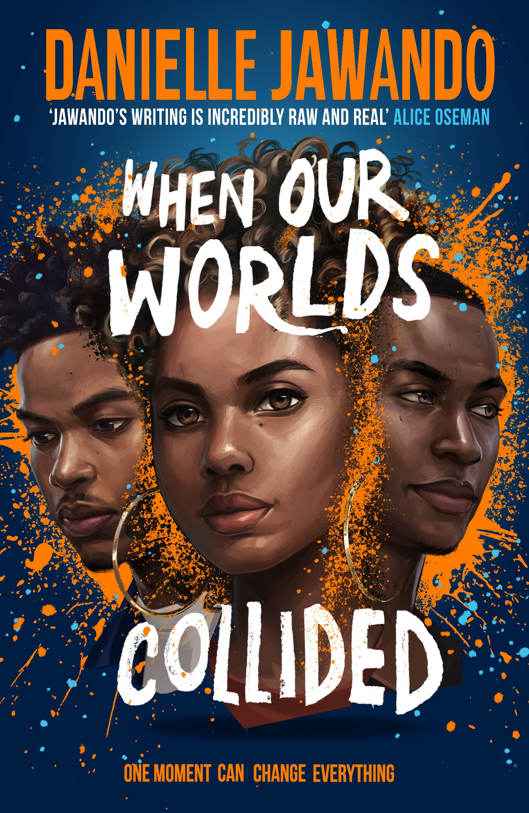
When our worlds collided
Danielle Jawando
When fourteen-year-old Shaq is stabbed outside of a busy shopping centre in Manchester, three teenagers from very different walks of life are unexpectedly brought together. What follows flips their worlds upside down and makes Chantelle, Jackson, and Marc question the deep-rooted prejudice and racism that exists within the police, the media, and the rest of society.

Slide 3

Book length 368 pages
First published 2022
Themes/ trigger warnings
Themes; racism, violence, class
Trigger warnings: racism, domestic abuse, murder, and gang violence
Book award and praise
Jhalak Prize winner
YA Book Prize Winner
‘Jawando’s writing is incredibly raw and real; I felt completely immersed’
Author details
An English author, Jawando was born in Manchester to an Irish-Nigerian father and an Irish-Ghanaian mother.

Slide 4
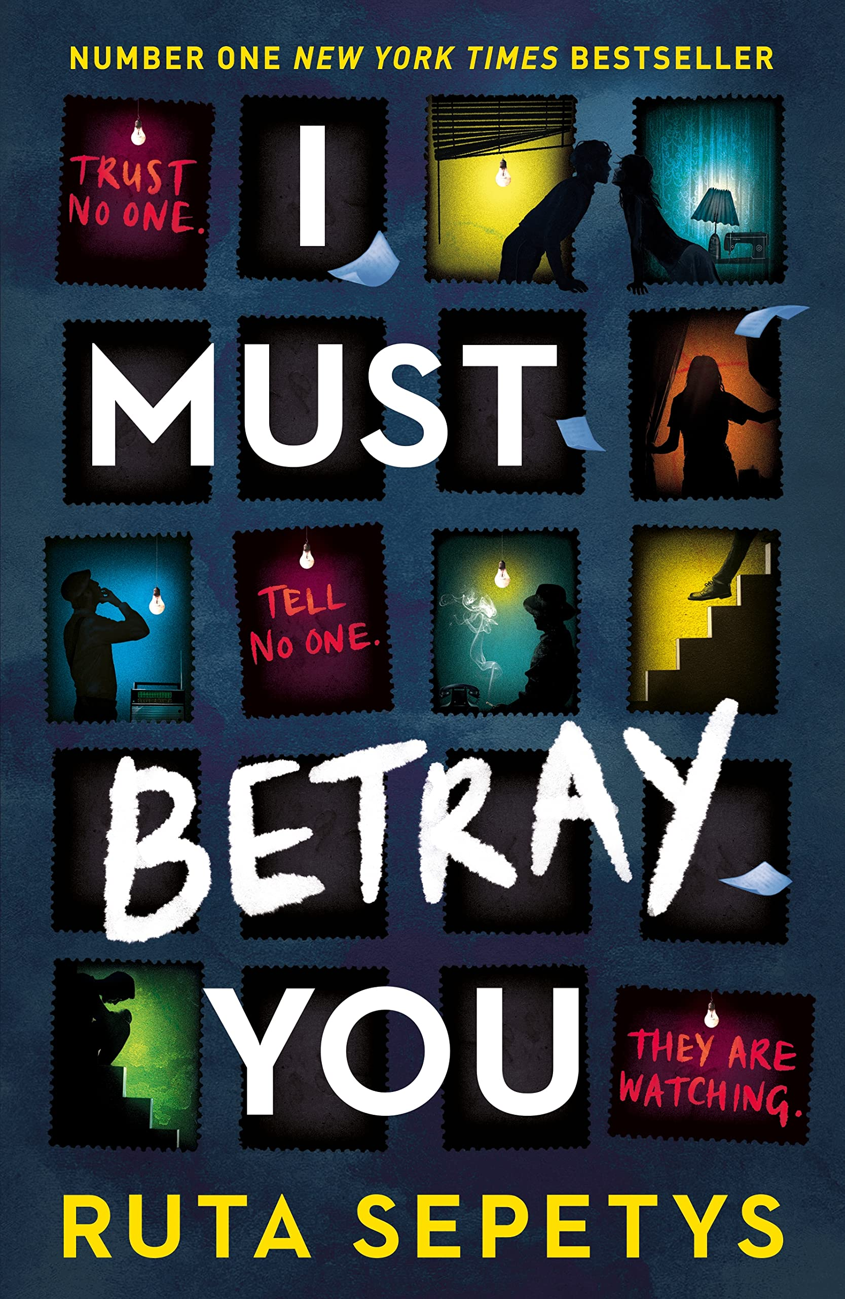
I must betray you
Ruta Sepetys
Trapped by an evil dictatorship, will Cristian be forced to betray his family or will he risk everything he loves to resist? A bestselling YA thriller based on real events, from a prizewinning author.
Cristian has lived his entire life in the grip of a repressive dictatorship. The country is governed by fear. When the secret police blackmail him, Cristian has an impossible choice. Save the life of his sick grandfather by informing on his family, or risk his life - and all of theirs - by resisting?
At 17, Cristian dreams of being free but doesn't know where to turn. In this climate of constant suspicion, can he trust his best friend, his girlfriend or even his family?

Slide 5
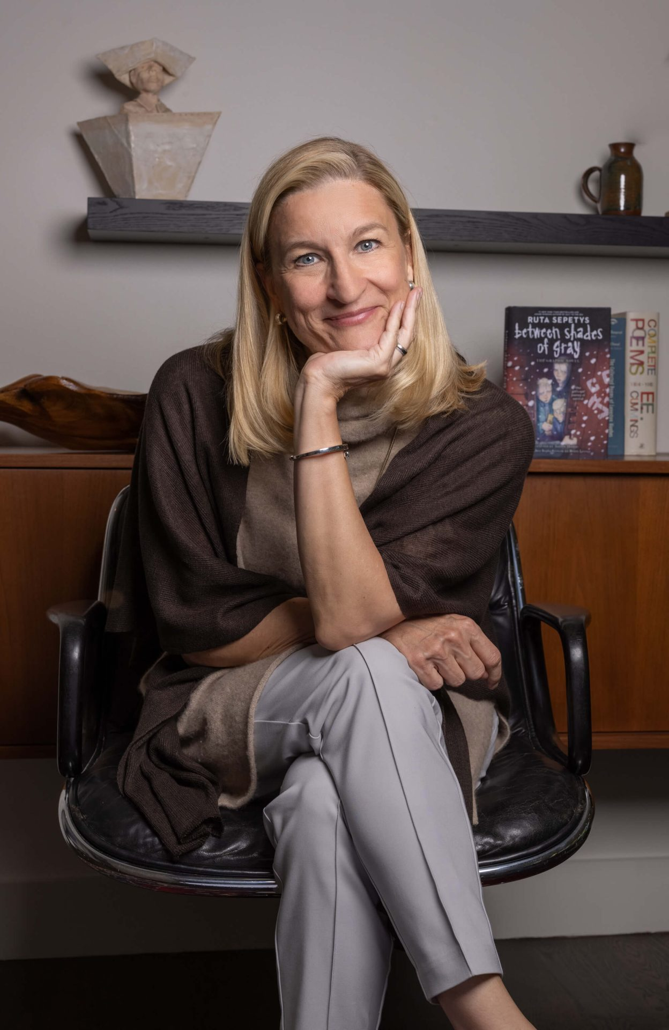
Book length 336 pages
First published 2022
Themes/ trigger warnings
Resistance, trust, betrayal, morality
The book contains themes that may be disturbing to some readers, including death of a family member, emotional abuse, genocide, gun violence, physical abuse, police brutality, torture, war, and violence.
Book award and praise
Goodreads Choice Award YA nominee
Carnegie Medal Award nominee
“Sepetys brilliantly blends a staggering amount of research with heart, craft, and insight in a way very few writers can . . . the novel crackles with energy. . . The last line will leave readers gasping. Compulsively readable and brilliant.”
Author details
Ruta Sepetys was born and raised in Michigan in a family of artists, readers, and music lovers. The daughter of a refugee, Ruta is drawn to underrepresented stories of strength through struggle and hopes to give voice to those who couldn't tell their story. Her award-winning historical novels are published in over sixty countries and have received over forty literary prizes.

Slide 6
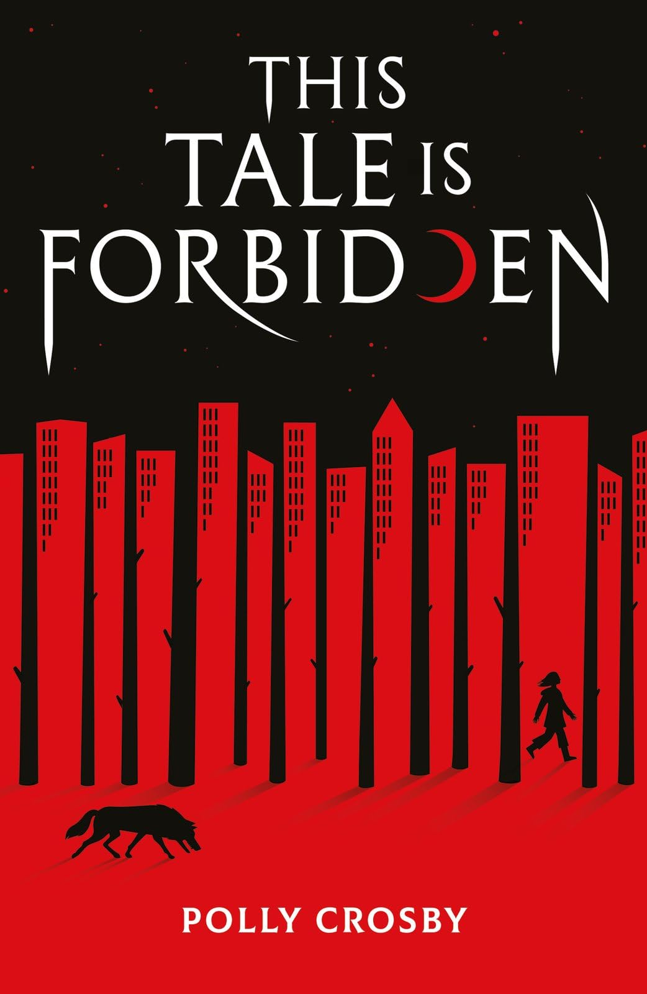
This tale is forbidden
Polly Crosby
Nesta believes in the fairy tales - the true stories of powerful magical women who shaped and ruled the world decades ago.
But the world has changed since then, and now, she is forbidden from wandering too far from the isolated woodland cottage where she lives with her grandmother. Nesta longs more than anything to see the city that lies beyond the forest, and when her grandmother is abducted, she gets her chance, journeying there in the hope of rescuing her.
But once there, she is horrified to see her grandmother's warnings were true: girls are forced to wear certain clothes and punished if they don't behave in certain ways. The city's Authorities have rewritten history, replacing the fairytale heroines with weak girls who must rely on men.
Worse still - everyone believes this is how the world has always been.
Only Nesta knows the truth. But truth is a dangerous thing, and suddenly she finds herself a target. Can she evade the Authorities long enough to rescue her grandmother and liberate everyone else, bringing magic back into the world?

Slide 7
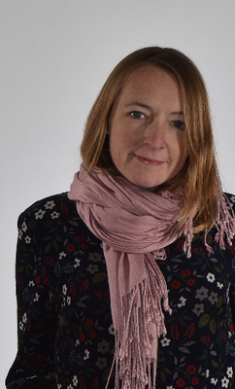
Book length 320 pages
First published 2024
Themes/ trigger warnings
Themes: forbidden knowledge, oppressive societal control, and the power of reclaiming stories
Book award and praise
“The Handmaid's Tale meets The Brother's Grimm in this thrilling dystopian fantasy”
Author details
English author from Suffolk, publishes for both children and adults.

Slide 8
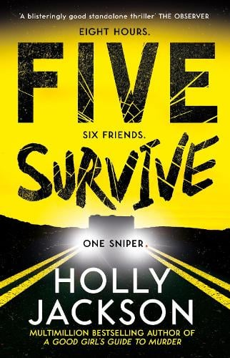
Five survive
Holly Jackson
Eighteen-year-old Red and her friends are on a road trip in an RV, heading to the beach for Spring Break.
It’s a long drive but spirits are high. Until the RV breaks down in the middle of nowhere. And as the wheels are shot out, one by one, the friends realise that this is no accident.
There’s a sniper out there. He’s watching them and he knows exactly who they are. One of the group has a secret that the sniper is willing to kill for.
As a game of cat-and-mouse plays out, the group desperately tries to get help. Buried secrets are forced to light and tensions within the group reach deadly levels. Only one thing is for sure. Not everyone will survive the night . . .

Slide 9
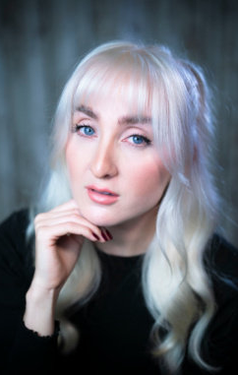
Book length 400 pages
First published 2023
Themes/ trigger warnings
Themes: trust, betrayal, secrets, and the psychological impact of survival situation
Trigger warnings: gun violence, death (including murder and death of a parent), violence, blood, and grief/trauma
Book award and praise
‘A blisteringly good standalone thriller.’
Observer YA book of the year
Goodreads choice award YA nominee
Author details
British author of mystery novels. Also pens the Good Girl’s Guide to Murder series, which was a massive TV hit for the BBC.

Slide 10
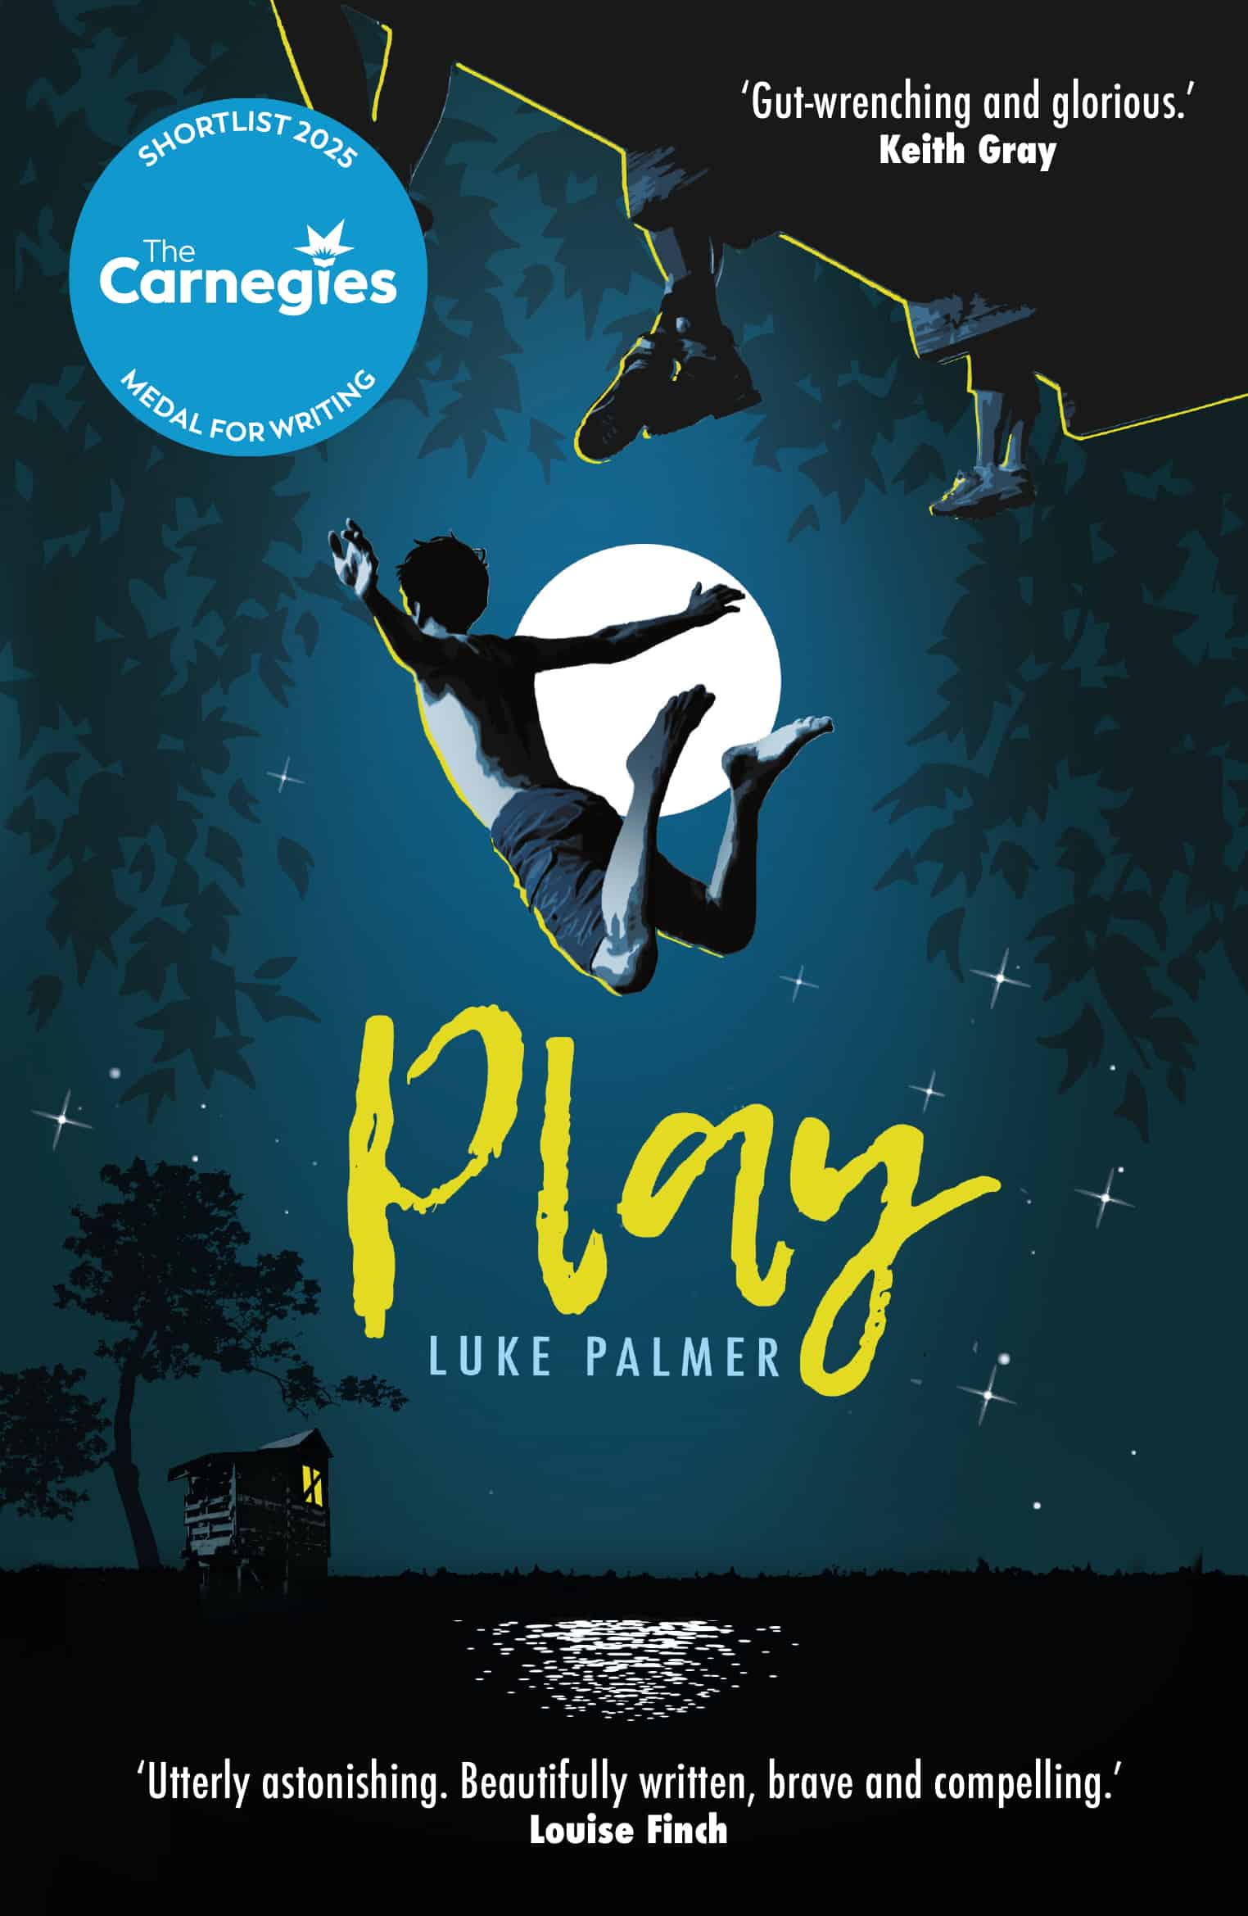
Play
Luke Palmer
Four boys grow up together at school, itching to get out of their small town. They play games, scoring points from each other, anything to pass the time until they're free.
Matthew slips into his imagination, Luc pushes his body to the limit, and Johnny... well who knows what Johnny's up to. But when Mark starts running errands for his older brother's mysterious associate, he thinks he's found the best game of all. There's money in his pocket and his friends have started looking at him differently.
Then Mark breaks a rule and quickly realises that the penalties in this game far outweigh the prizes. Can they all make it to the finish line before someone loses more than just face?

Slide 11
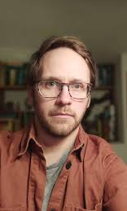
Book length 320 pages
First published 2023
Themes/ trigger warnings
Themes: boyhood, male friendship, modern-day masculinity and the loss of innocence
Trigger warnings: drug-taking and trafficking, drinking, strong language, implied sexual assault, death, misogyny, homophobia, toxic masculinity, neglect.
Book award and praise
‘Boys will be boys but will strive to become so much more in Luke Palmer's wonderfully astute and truthful story. It's the best book of young male friendship I've read in years. Gut-wrenching and glorious’
Carnegie medal nominee
Author details
Luke Palmer is a critically acclaimed YA author and a prize-winning poet. He lives in Wiltshire with his partner, their three daughters, a dog, and a cat.

Slide 12
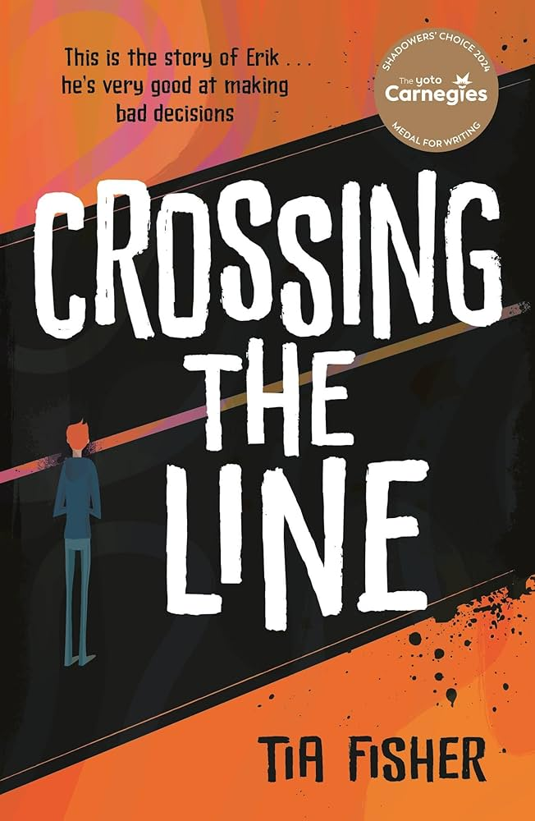
Crossing the line
Tia Fisher
Erik's life has been falling apart ever since his dad died. Homework and being good at school stop feeling important when you're the new man of the house. When Erik's bad behaviour attracts the wrong crowd, he's sucked into a terrifying new world of drug dealing, trap houses and violence.
Making money feels good but Erik soon learns that a small favour can become a huge debt.
And when his sisters' lives are threatened, Erik will have to cross one more line to save them.

Slide 13
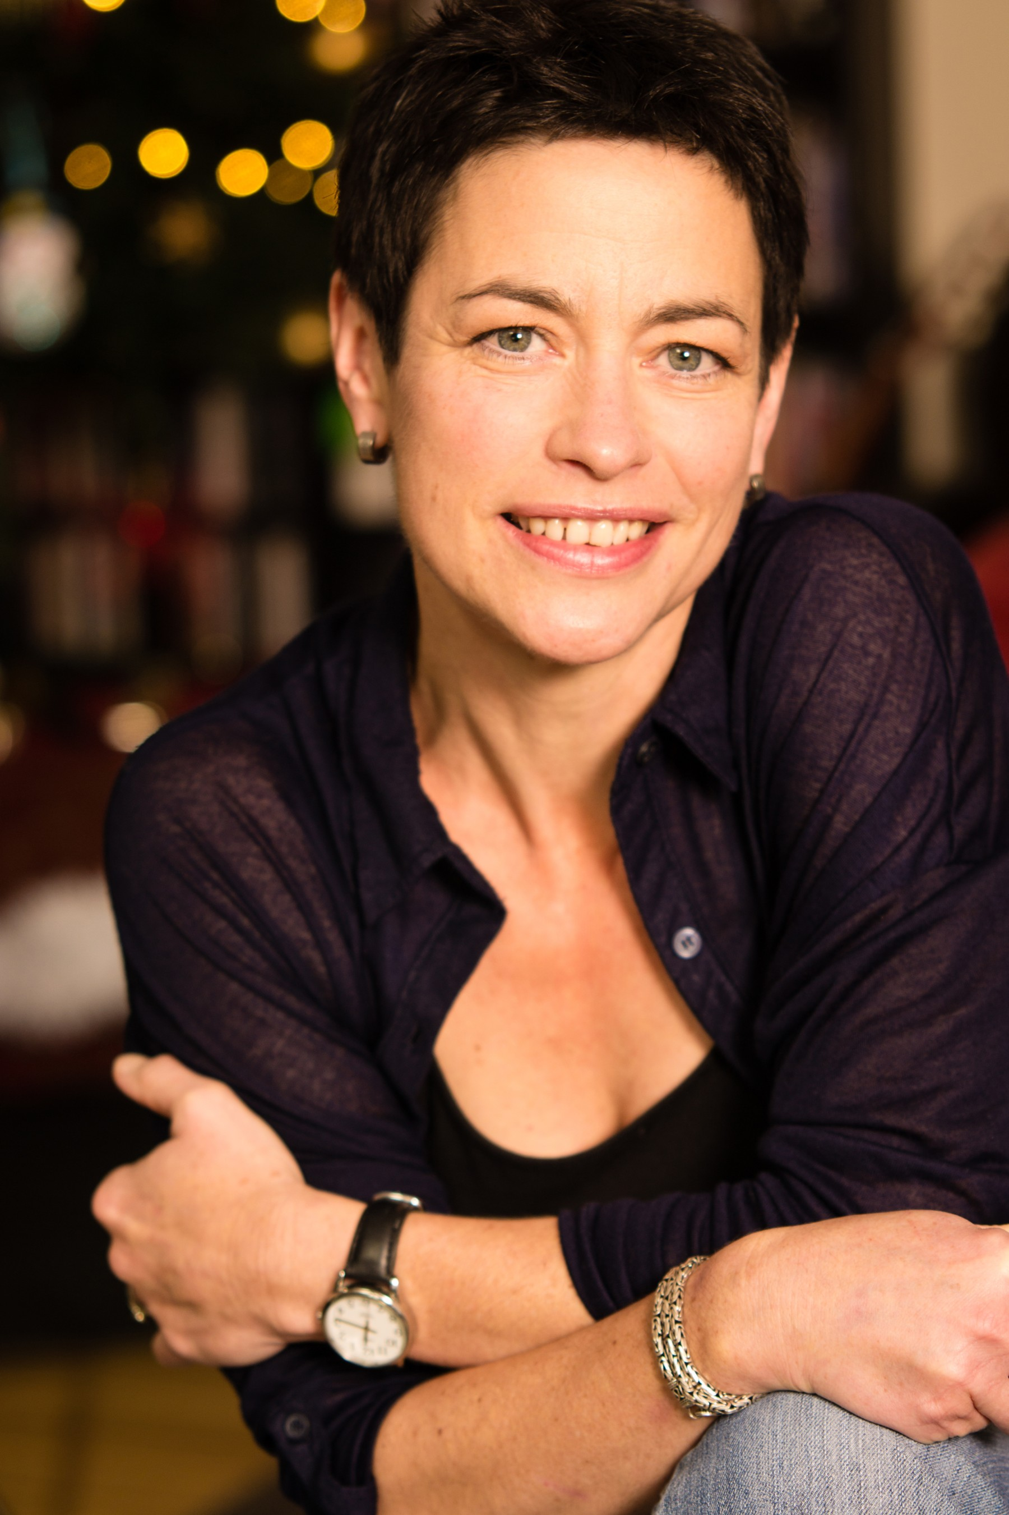
Book length 368 pages
First published 2023
**This book is written in verse**
Themes/ trigger warnings
Themes: bullying, bereavement, coercion, county lines, decision-making, drugs, empathy/compassion, families, friendship, poverty, relationships, resilience. risk-taking.
Trigger warnings: strong language and some violent scenes
Book award and praise
‘Just wow. Incredible voice, impeccably crafted - so funny, moving and terrifyingly real. A verse novel for our times. I read it, then read it again. So will you. ’
Times Childrens’ Book of the Year
UK Literacy Association Book Award winn
Carnegie Medal Shadower’s award winner
Author details
An author from south-east England, writing from middle-grade to YA in prose and verse. I love exploring important issues: writing gritty, realistic fiction for young people; accessible fiction that opens conversations.

Slide 14
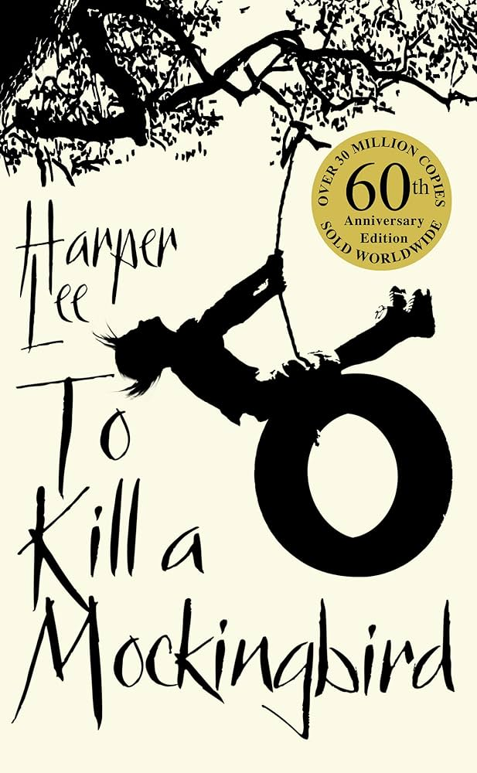
To kill a mockingbird
Harper Lee
'Shoot all the bluejays you want, if you can hit 'em, but remember it's a sin to kill a mockingbird.'
A lawyer's advice to his children as he defends the real mockingbird of Harper Lee's classic novel - a black man charged with a serious crime.
Through the young yes of Scout and Jem Finch, Harper Lee explores the irrationality of adult attitudes to race and class in the Deep South of the 1930s.
The conscience of a town steeped in prejudice, violence and hypocrisy is pricked by the stamina of one man's struggle for justice.
But the weight of history will only tolerate so much.

Slide 15
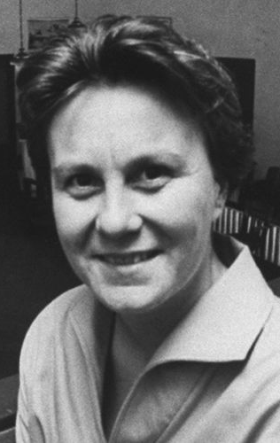
Book length 320 pages
First published 1960
Themes/ trigger warnings
Themes: prejudice, social inequality, courage, family, and the coexistence of good and evil
Trigger warnings: racism, racial slurs, violence (including gun violence, knife violence, and murder), sexual assault (including rape), and animal death
Book award and praise
‘It would be difficult to argue that Harper Lee’s classic isn’t one of the most―if not the most―beloved of American novels’
Pulitzer prize for fiction winner
Author details
American novelist. Lee received numerous accolades and honorary degrees, including the Presidential Medal of Freedom in 2007, which was awarded for her contribution to literature

Slide 16
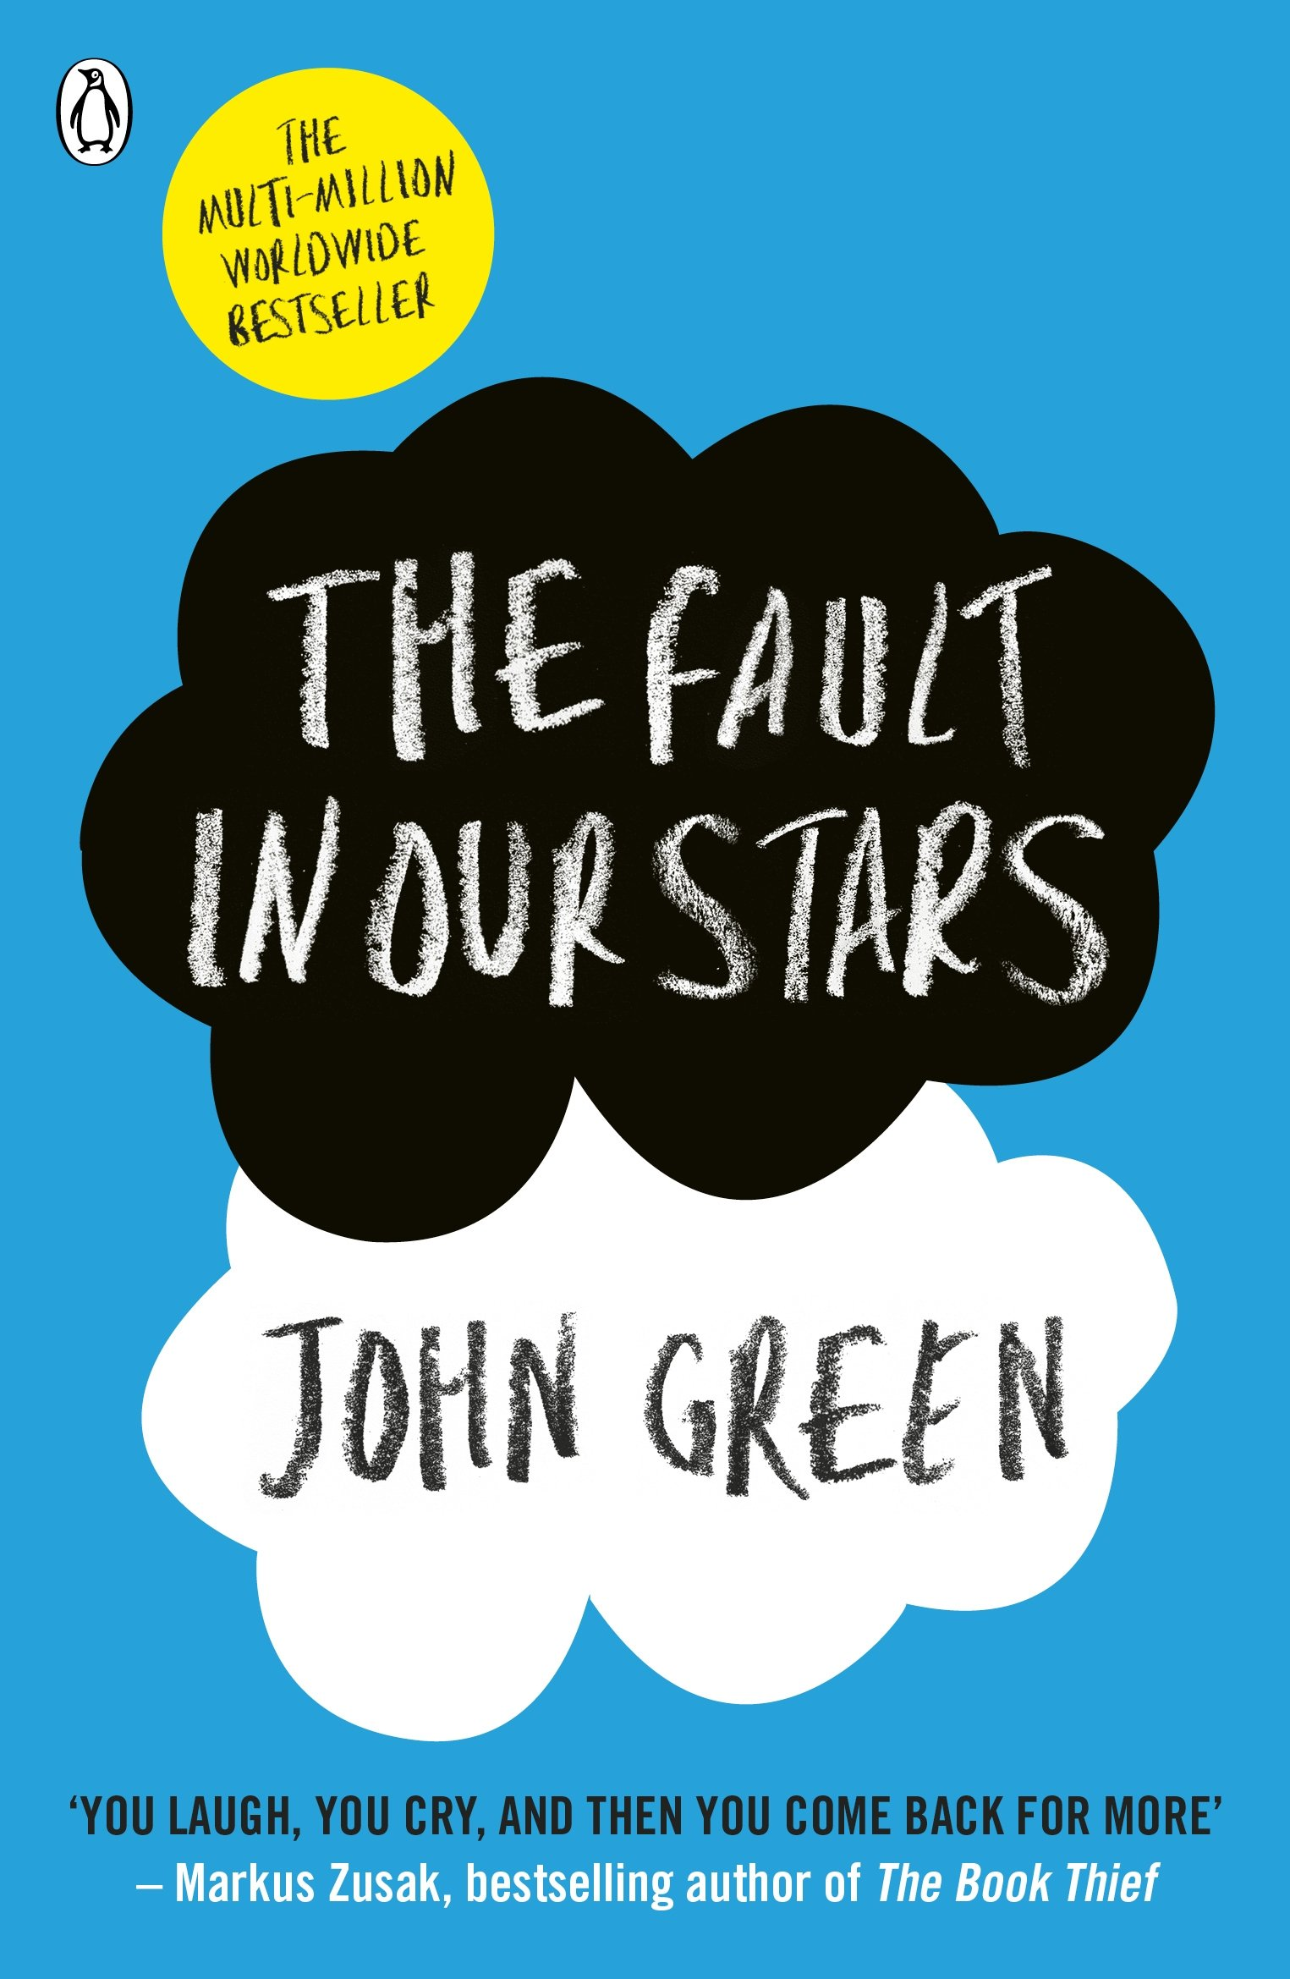
The fault in our stars
John Green
I fell in love the way you fall asleep: slowly, then all at once.
Despite the tumour-shrinking medical miracle that has bought her a few years, Hazel has never been anything but terminal, her final chapter inscribed upon diagnosis.
But when a gorgeous plot twist named Augustus Waters suddenly appears at Cancer Kid Support Group, Hazel's story is about to be completely rewritten.

Slide 17

Book length 352 pages
First published 2013
Themes/ trigger warnings
Themes: love, loss, and the human experience of facing mortality., the complexities of life, death, and the search for meaning in the face of terminal illness
Trigger warnings: cancer and its impact, descriptions of illness, death, and grief, as well as depictions of emotional distress and near-death experiences
Book award and praise
‘The love affair of two terminally ill teenagers could be mawkish. In fact, it's funny, clever, irreverent and life-affirming.’
Indies choice book award winner
Goodreads choice award YA winner
Author details
American author and YouTuber whose books have sold more than 50 million copies worldwide

Slide 18
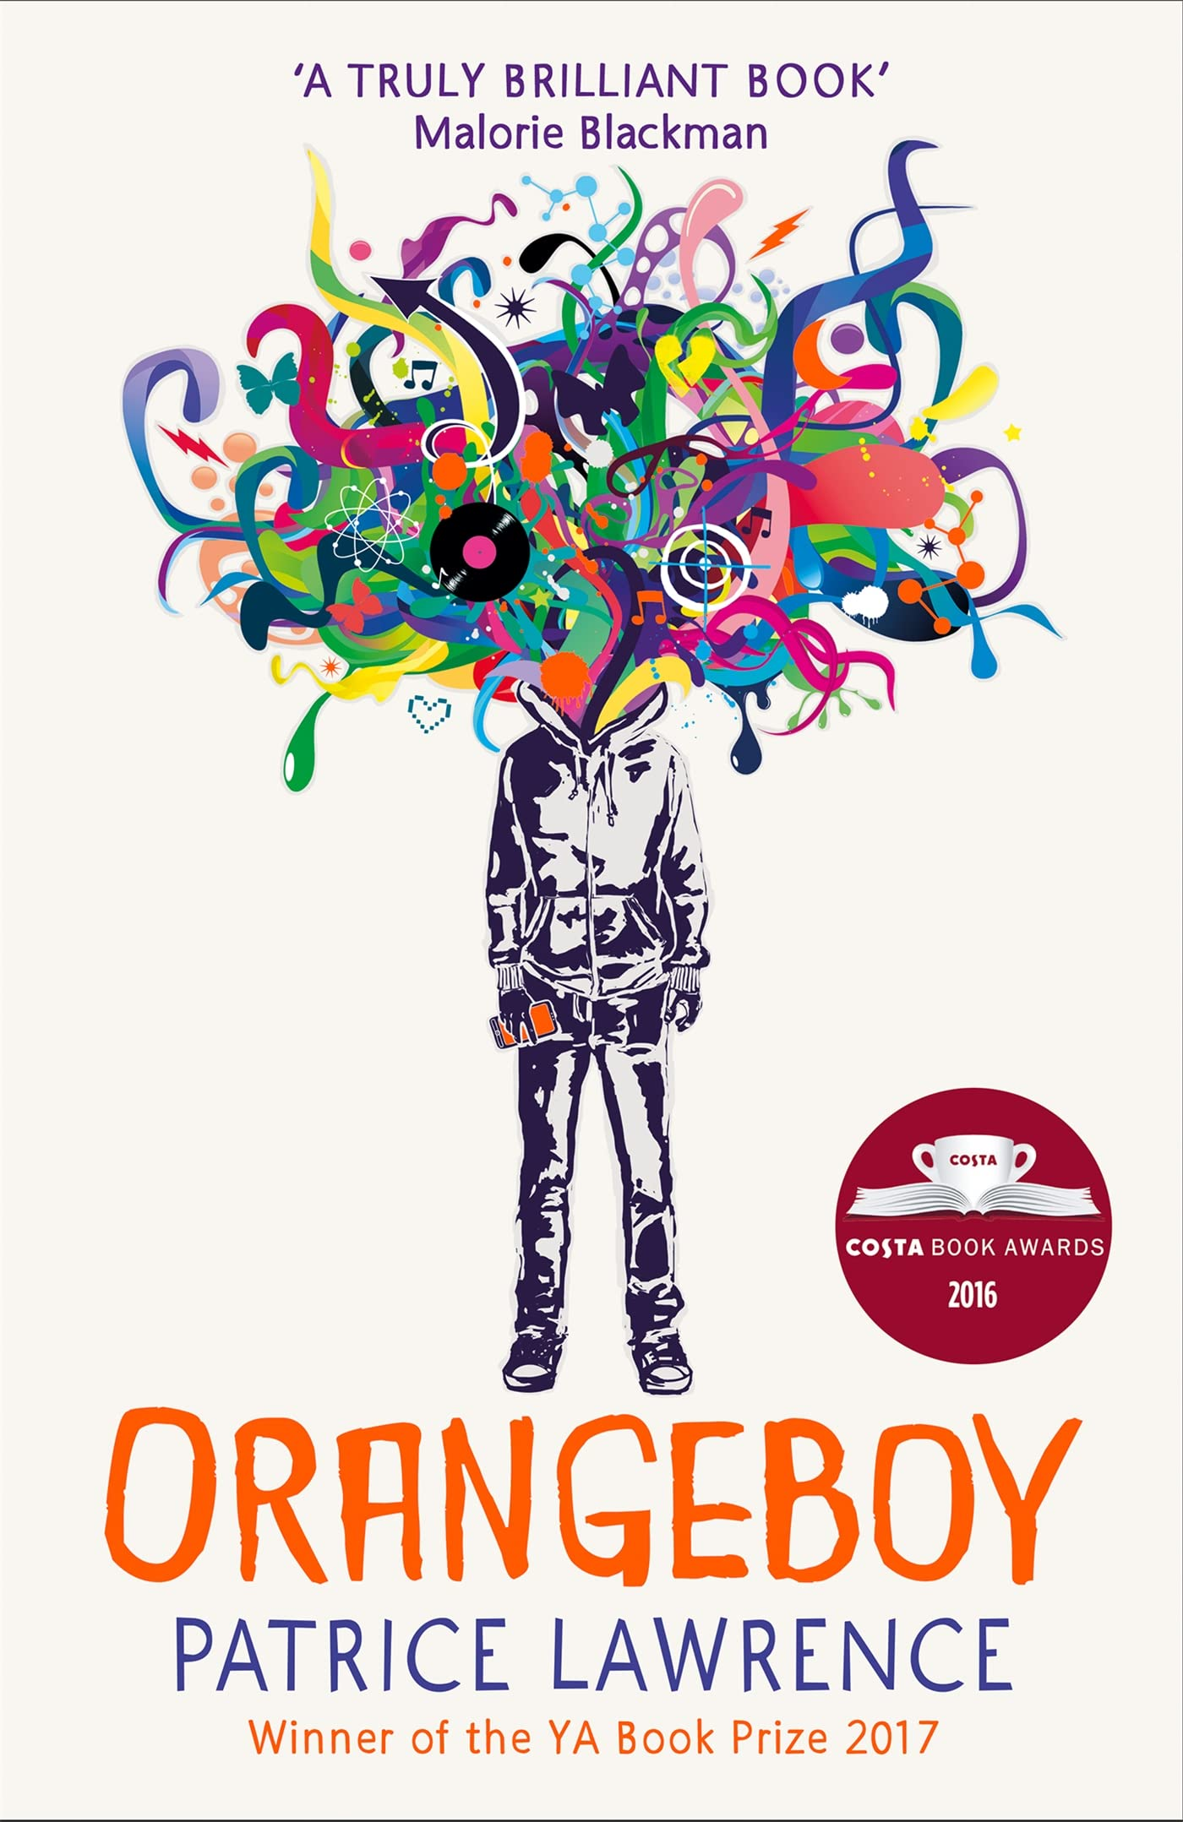
Orangeboy
Patrice Lawrence
Not cool enough, not clever enough, not street enough for anyone to notice me. I was the kid people looked straight through.
NOT ANYMORE. NOT SINCE MR ORANGE.
Sixteen-year-old Marlon has made his mum a promise - he'll never follow his big brother, Andre, down the wrong path. So far, it's been easy, but when a date ends in tragedy, Marlon finds himself hunted. They're after the mysterious Mr Orange, and they're going to use Marlon to get to him. Marlon's out of choices - can he become the person he never wanted to be, to protect everyone he loves?

Slide 19

Book length 448 pages
First published 2016
Themes/ trigger warnings
Themes: family, loyalty, and the impact of gang culture on young people
Trigger warnings: physical violence, drug use, and gang activity, as well as references to parental neglect, abuse, and death
Book award and praise
“What a book! Such a gripping, gritty storyline, with such wonderful, believable characters. Loved it”
Booksellers YA Prize – winner
Waterstones book prize for older children - winner
Author details
British author who grew up in Brighton in an Italian-Trinadian family. Awarded an MBE for literature in 2021.

Slide 20
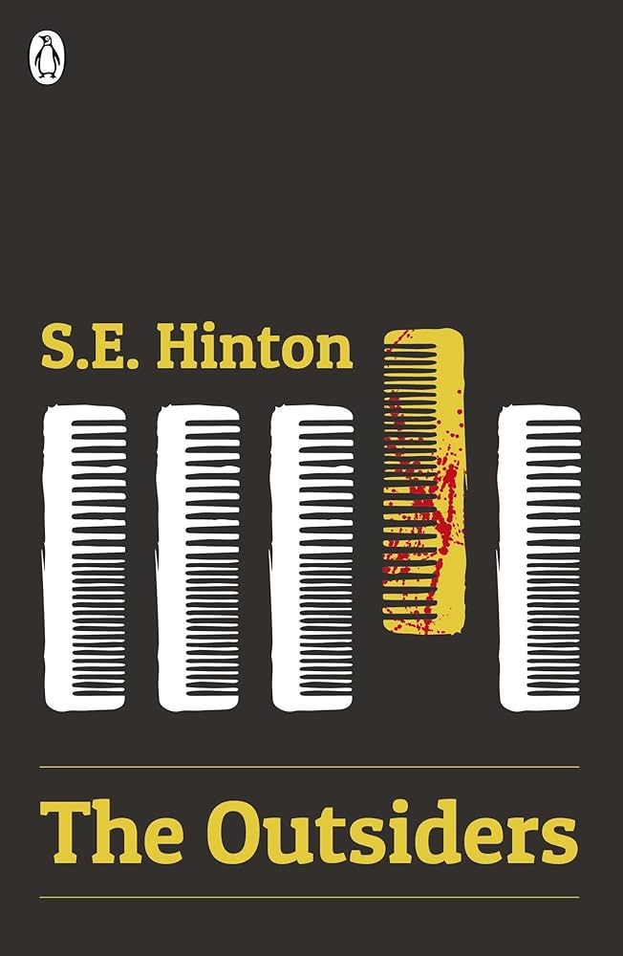
The outsiders
SE Hinton
Teenagers in a small Oklahoma town have split into two gangs, divided by money, tastes and attitude. The Socs' idea of having a good time is beating up Greasers like Ponyboy Curtis.
Ponyboy knows what to expect and knows he can count on his brothers and friends - until the night someone takes things too far, and life is changed forever.

Slide 21
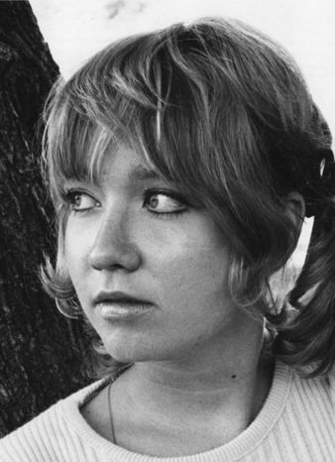
Book length 224 pages
First published 1967
Themes/ trigger warnings
Themes: social class divisions, identity, family and friendship, and coming of age
Trigger warnings: violence, underage drinking and smoking, strong language, and family dysfunction, death, grief, and social inequality
Book award and praise
“The Outsiders is gritty, honest and authentic, and a novel that I feel every teenager needs to read’
Awards for secondary - winner
Author details
American writer was and still is, one of the most popular and best-known writers of young adult fiction. Her books have been taught in some schools and banned from others. Her novels changed the way people look at young adult literature.

Slide 22
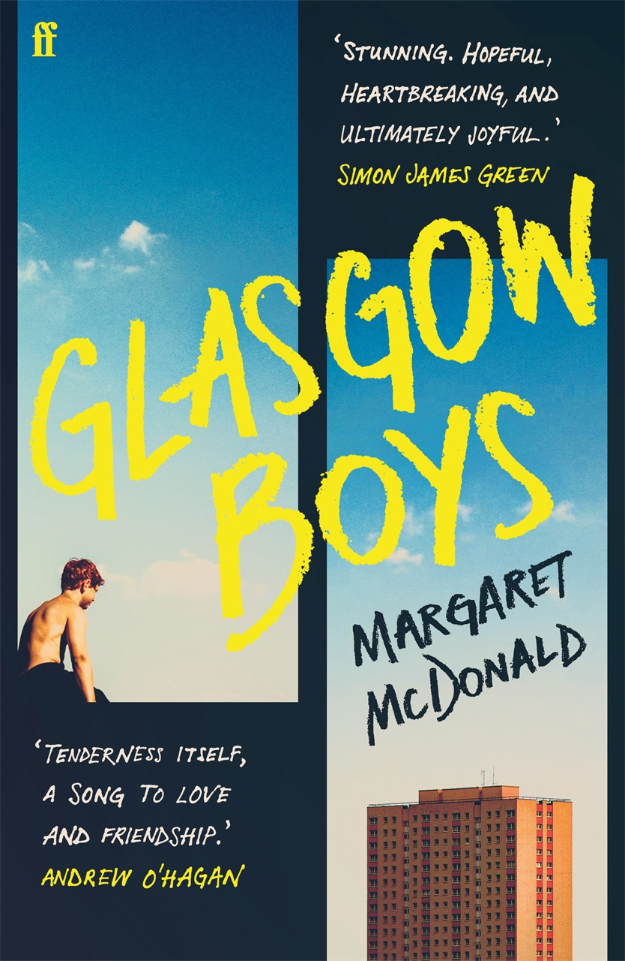
Glasgow Boys
Margaret McDonald
Two boys can't remember the last time they had a hug.
Meet Finlay. He's studying for his nursing degree at Glasgow University, against all the odds. But coming straight from care means he has no support network.
How can he write essays, find paid work and NOT fall for the beautiful boy at uni, when he's struggling to even feed himself?
Meet Banjo. He's trying to settle in with his new foster family and finish high school. But he can't forget all that has happened, and his anger and fear keep boiling over.
How can he hold on to the one good person in his life, when his outbursts keep threatening his already uncertain future?
Can Finlay and Banjo let go of the past before it drags them under?

Slide 23

Book length 352 pages
First published 2024
Themes/ trigger warnings
Themes: toxic masculinity as a catalyst for male loneliness
Trigger warnings: foster care, mental health, addiction and suicide/suicidal thoughts
Book award and praise
“Tenderness itself, a song to love and friendship.”
Carnegie medal – winner
UK Literacy Award – winner
A 2025 “read for empathy” book
Author details
A Scottish author, this is her first published novel.

Slide 24
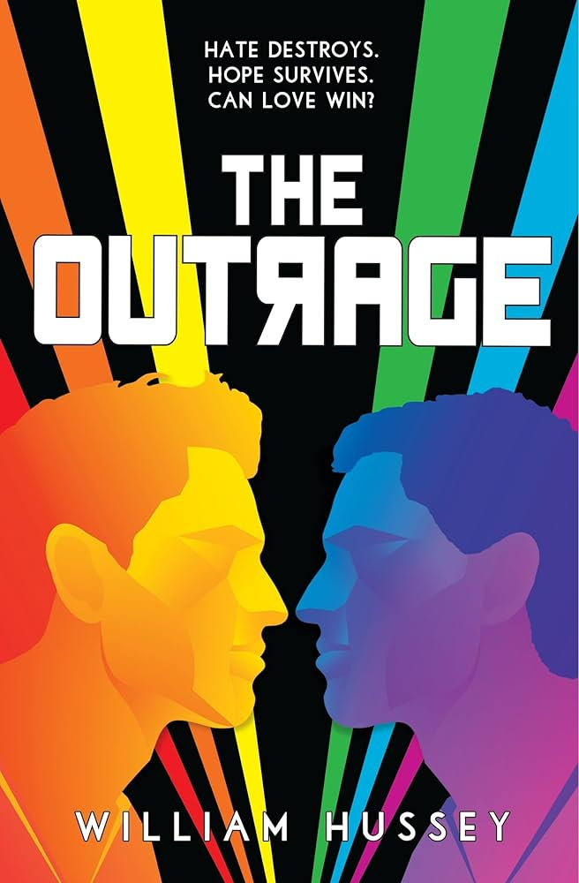
The Outrage
William Hussey
Welcome to England, where the Protectorate enforces the Public Good. Here, there are rules for everything - what to eat, what to wear, what to do, what to say, what to read, what to think, who to obey, who to hate, who to love. Your safety is assured, so long as you follow the rules.
Gabriel is a natural born rule-breaker. And his biggest crime of all? Being gay.
Gabriel knows his sexuality must be kept secret from all but his closest friends, not only to protect himself, but to protect his boyfriend. Because Eric isn't just the boy who has stolen Gabriel's heart. He's the son of the chief inspector at Degenerate Investigations ­­­- the man who poses the single biggest threat to Gabriel's life.
And the Protectorate are experts at exposing secrets.

Slide 25
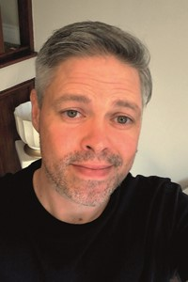
Book length 326 pages
First published 2021
Themes/ trigger warnings
Themes: Being gay/apart of the LGBT+ community is a crime in many countries and this book highlights those issues and makes its readers aware of the difficulties that many queer people face.
Trigger warnings: homophobia and homophobic language, self-harm, references to suicide, and scenes of violence
Book award and praise
“A page-turning read. It's no surprise that Usborne claims that this is The Handmaid's Tale for LGBTQ+”
Author details
William Hussey is an award-winning British author of books for children and young adults. As a gay man and a visiting author, he has spoken to hundreds of LGBTQ+ students worldwide. Will is a dazzling new voice in UK YA.

Slide 26
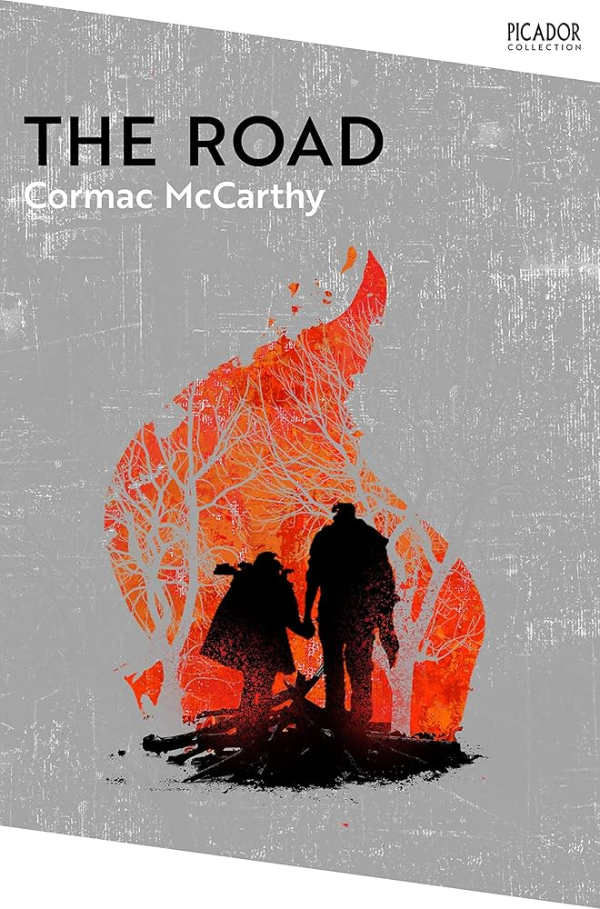
The Road
Cormac McCarthy
A father and his son walk alone through burned America. Nothing moves in the ravaged landscape save the ash on the wind. It is cold enough to crack stones, and when the snow falls it is gray. The sky is dark. Their destination is the coast, although they don’t know what, if anything, awaits them there. They have nothing; just a pistol to defend themselves against the lawless bands that stalk the road, the clothes they are wearing, a cart of scavenged food—and each other.

Slide 27
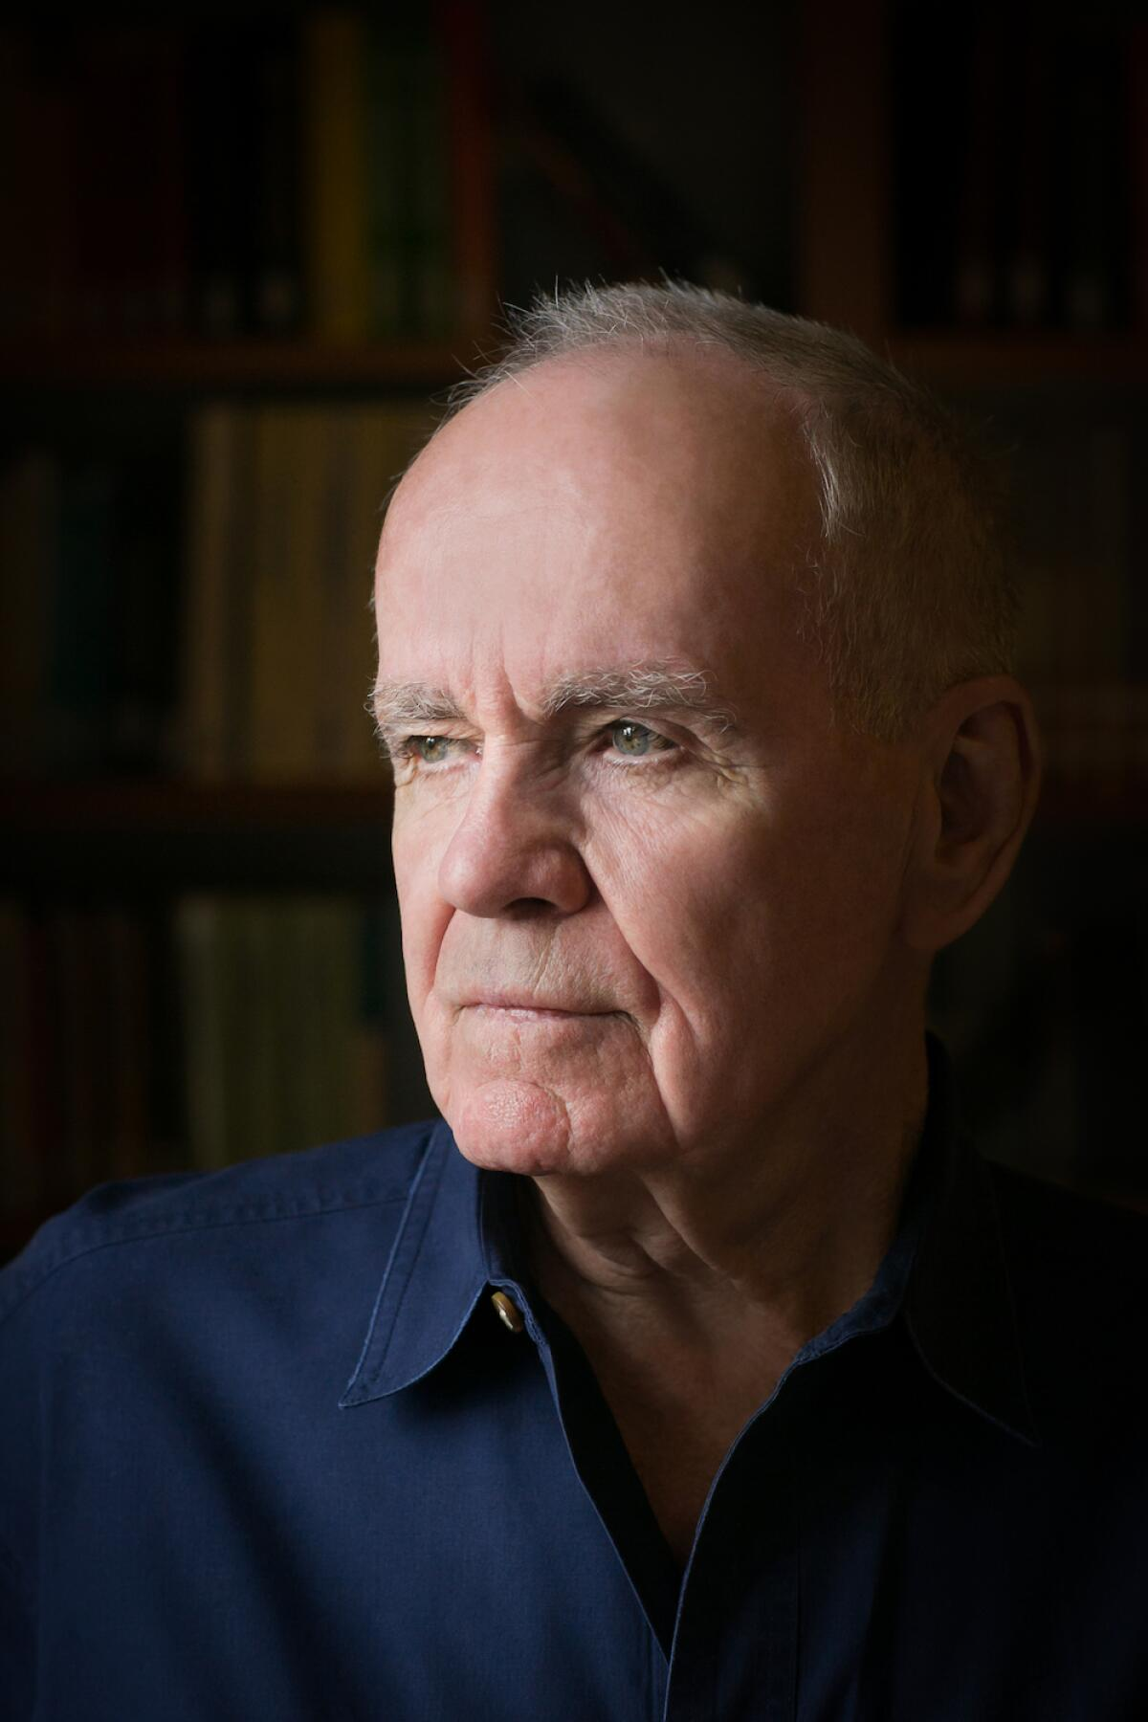
Book length 336 pages
First published 2006
Themes/ trigger warnings
Themes: death and violence, familial love, survival and perseverance, faith, trust, and doubt, and dreams and memory.
Book award and praise
“The Outsiders is gritty, honest and authentic, and a novel that I feel every teenager needs to read’
Pultizer prize winner
NY Times 100 best books of the 21st century
Author details
Cormac McCarthy was a highly acclaimed American novelist and screenwriter celebrated for his distinctive literary style, philosophical depth, and exploration of violence, morality, and the human condition

